Slide 1
FAI Information
Model Family PN | 7622776-33264
Build Config | net.ad_cfab_v2_t1_t2_2.14
Manufacturing Site | MiTAC-ZOU
FAI State | Pretest
Submission Date | 08-01-2026
Rack Serial Number | 2551HC8001
Sample Number (if applicable) | 1
Factory Shift Built On | 24-12-2025
Submitter | Kristianed.dumelod
Related ECO/DA/PA | PA54825
L11 BOM PN and Revision | 8230639 Rev 02
L11 Mechanical Spec PN and Revision | 8230641 Rev 03
FAI Classification (‘X’ mark applicable) | Pretest | Packout
New Product Introduction | X
Sample Build after Initial FAI
Product Revision Change
FAI Rev | Manufacturing Site Approver | Date | Changes from Previous Revision
01 | <Ross Mandis>, <ME> |  | NA
L11 FAI Template
PN: 8206792
Rev: 05
Date Released: 08/12/2021
This document is considered confidential to and is maintained as trade secret by Oracle Corporation.
This document is disclosed pursuant to a non-disclosure agreement and/or other written agreement between the recipient and Oracle Corporation (collectively, the “Agreement(s)”).
Any reproduction, distribution, or public discussion of this material is subject to the limits described in the Agreement(s) with Oracle Corporation. Information in this document is restricted to Oracle authorized recipients only.

Slide 2
Pretest Rack Inspection Checklist - L11 Rack Assembly
Step | Details | Comments | Pass/Fail
1 | All PA’s / Deviations have been understood and executed |  | PASS
2 | Conformance to Oracle BOMs and assembly drawings |  | PASS
 | a. Ensure that all Marketing part numbers match (BOM, Labels, and Oracle order details) |  | PASS
 | b. Ensure that all Manufacturing part numbers match (BOM, Labels, and Oracle order details) |  | PASS
 | c. Ensure that all Serial numbers match (BOM, Labels, and Oracle order details) |  | PASS
3 | Conformance to supplier BOMs and assembly drawings |  | PASS
4 | Conformance to Oracle cosmetic spec; 923-2001-[ ] rev[ ] |  | PASS
5 | Conformance to Oracle RoHS spec; 914-1742-[ ] rev[ ] |  | PASS
6 | Ensure all devices, filler panels and shelves are installed per the rack elevation and pass cosmetic specifications |  | PASS
7 | Ensure all devices are secured to the rack. Screws are tight and rail latches lock |  | PASS
8 | Ensure all rack mounted devices are removable per the rack serviceability requirements |  | PASS
9 | Ensure all cables are correctly labeled and the label content is readable |  | PASS
10 | Ensure all cables are routed without violating cable bend radius rules |  | PASS
11 | Ensure no cables obstruct the path of server removal out the front of the rack |  | PASS
12 | Ensure all rack ground clips are fully connected |  | PASS
13 | Ensure no debris is under the rack. Ensure pallet deck channels are clear of debris (critical safety item) |  | PASS
14 | PDU labels are installed |  | PASS
15 | All cables are latched. Give a slight pull/push to latching connectors to ensure cable is fully seated and latched. Push all power cable to ensure they are fully seated. |  | PASS
16 | Ride along parts are clearly identified and match BOM |  | PASS
17 | All rack and device SN number labels are placed per L11 Mfg Requirements spec, legible and scannable |  | PASS
18 | Ensure keys can lock and unlock side panels and/or doors |  | PASS
19 | Rack key set is secured to the front rail or front door per L11 Mfg Requirements spec |  | PASS
20 | [If Applicable] Storekeeper Name labels are placed per L11 Mfg Requirements spec and content match the product specification |  | PASS
21 | [If Applicable] RFID / Asset tags are installed per L11 Mfg Requirements spec, legible and scannable | applying asset Tags at packout | NA

Slide 3
Pretest FAI Photo Requirements and View Legend
 | Photo Angle
 | 45° Left | Straight-On | 45° Right
Front of Rack
Full Rack | FR3 | FR1 | FR2
Top Half | FR6 | FR4 | FR5
Bottom Half | FR9 | FR7 | FR8
Switches | SW3 | SW1 | SW2
Servers | SV3 | SV1 | SV2
Other Rack Mounted Systems | MS3 | MS1 | MS2
All applied labels |  | LB1
Rear of Rack
Full Rack | RR3 | RR1 | RR2
Top Half | RR6 | RR4 | RR5
Bottom Half | RR9 | RR7 | RR8
Switches | SW6 | SW4 | SW5
Switch Cabling (if possible) View from above 45-60° |  | SW7
Switch Cabling (if possible) View from below 45-60° |  | SW8
Servers | SV6 | SV4 | SV5
Other Rack Mounted Systems | MS6 | MS4 | MS5
All applied labels |  | LB1
Side A Cabling (only if there is cabling on the side of the rack)
Full Rack |  | SA1
Top Half |  | SA2
Bottom Half |  | SA3
Side B Cabling (only if there is cabling on the side of the rack)
Full Rack |  | SB1
Top Half |  | SB2
Bottom Half |  | SB3
To-From Cable Labels
Legible photo of each cable type |  | LB2

Slide 4
Rack Elevation (7622776_net.ad_cfab_v2_t1_t2_2.14-Rack Spec_rev3)

Slide 5
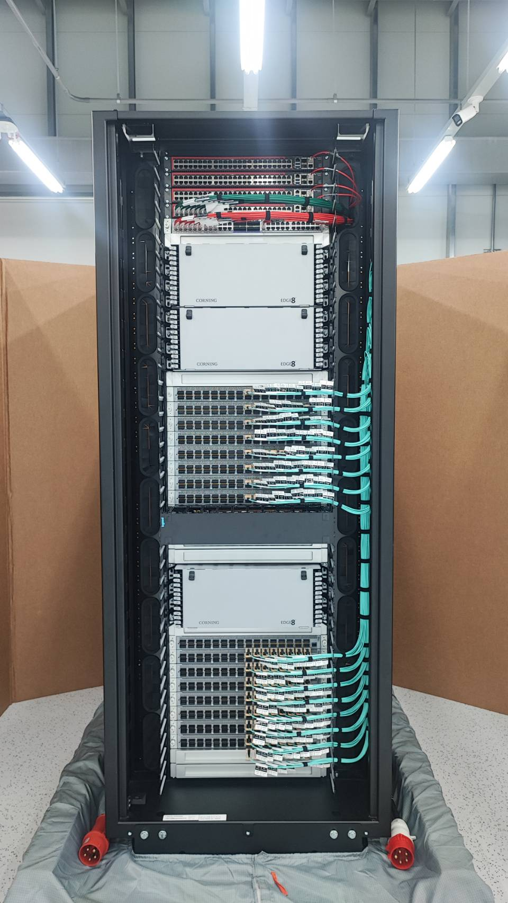
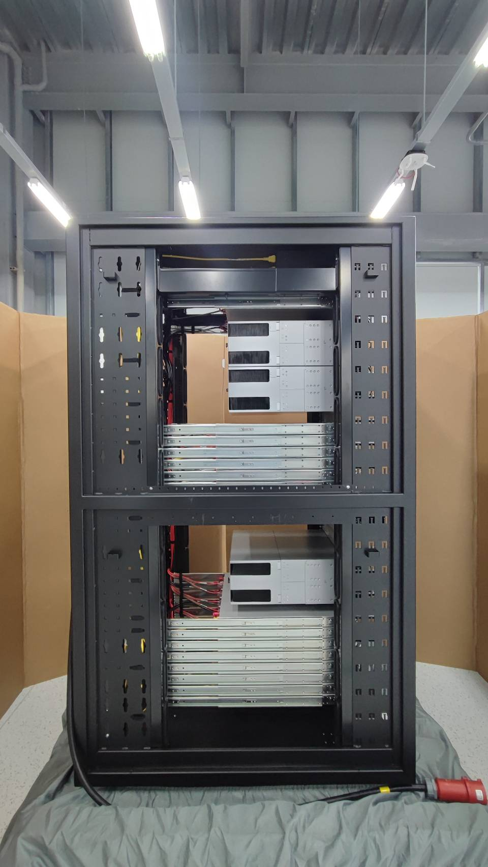
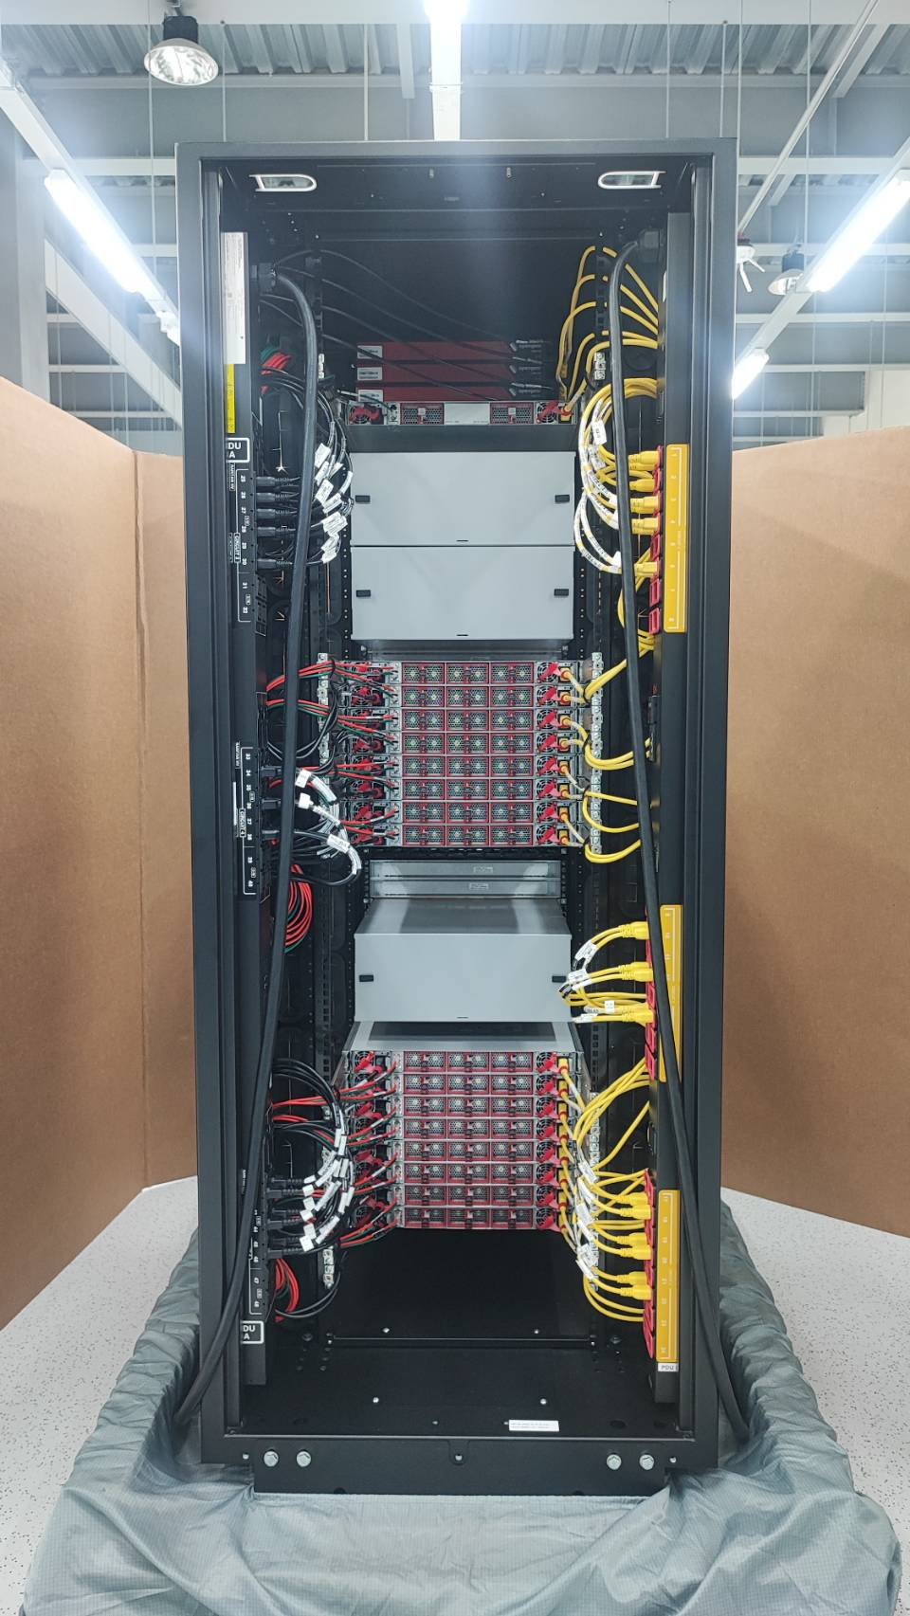
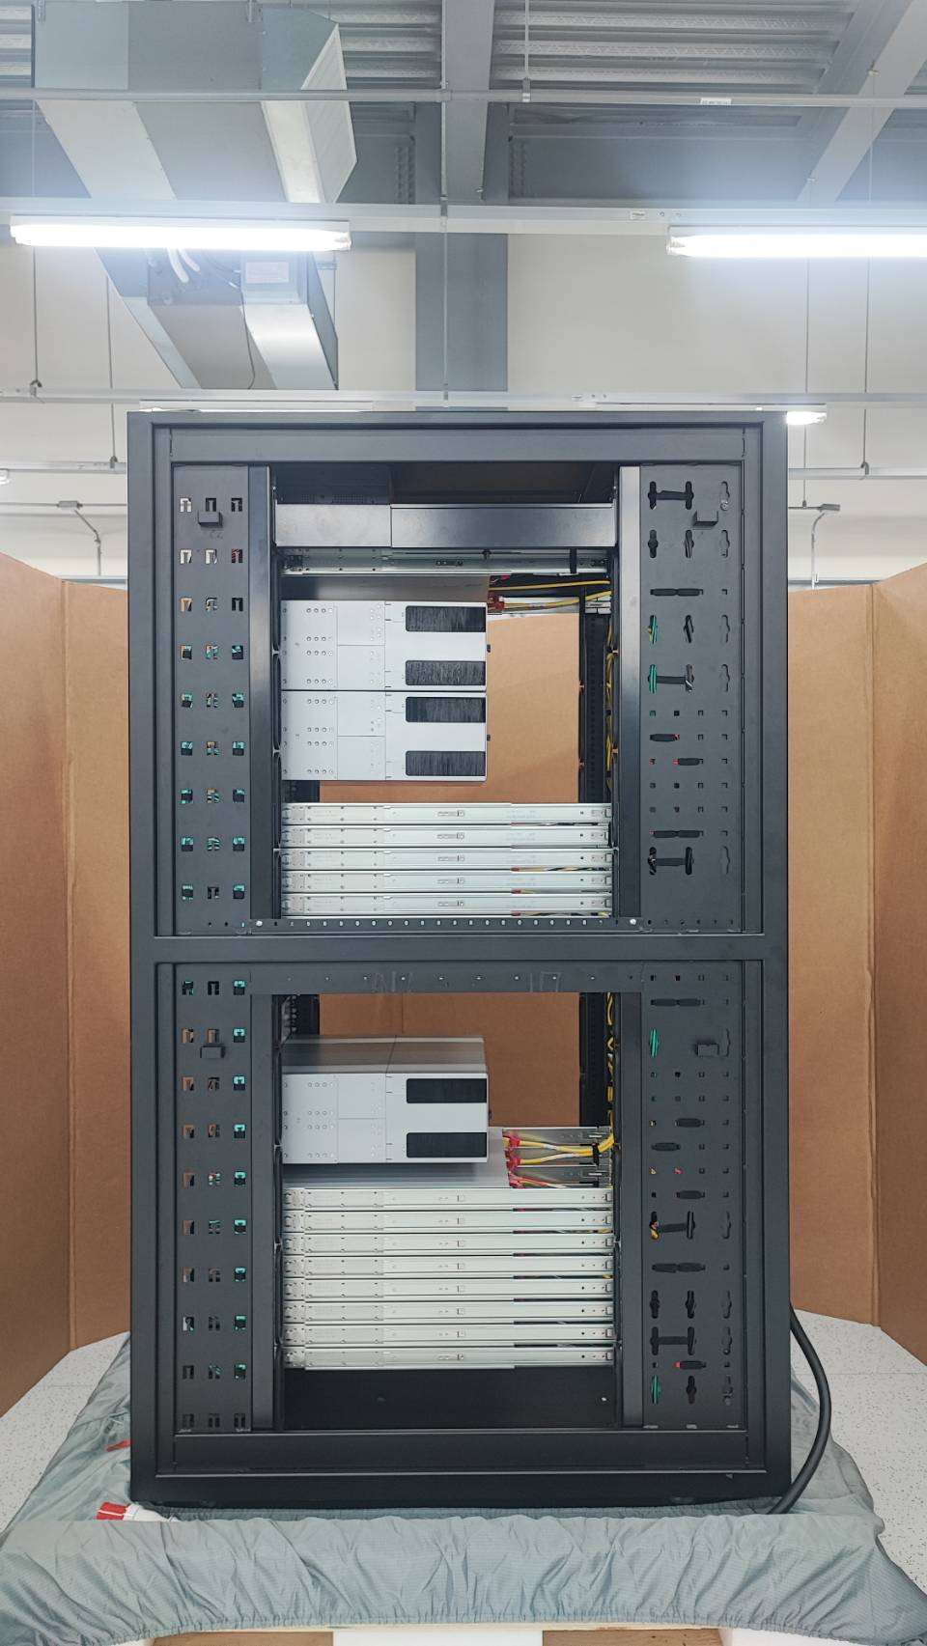

Slide 6
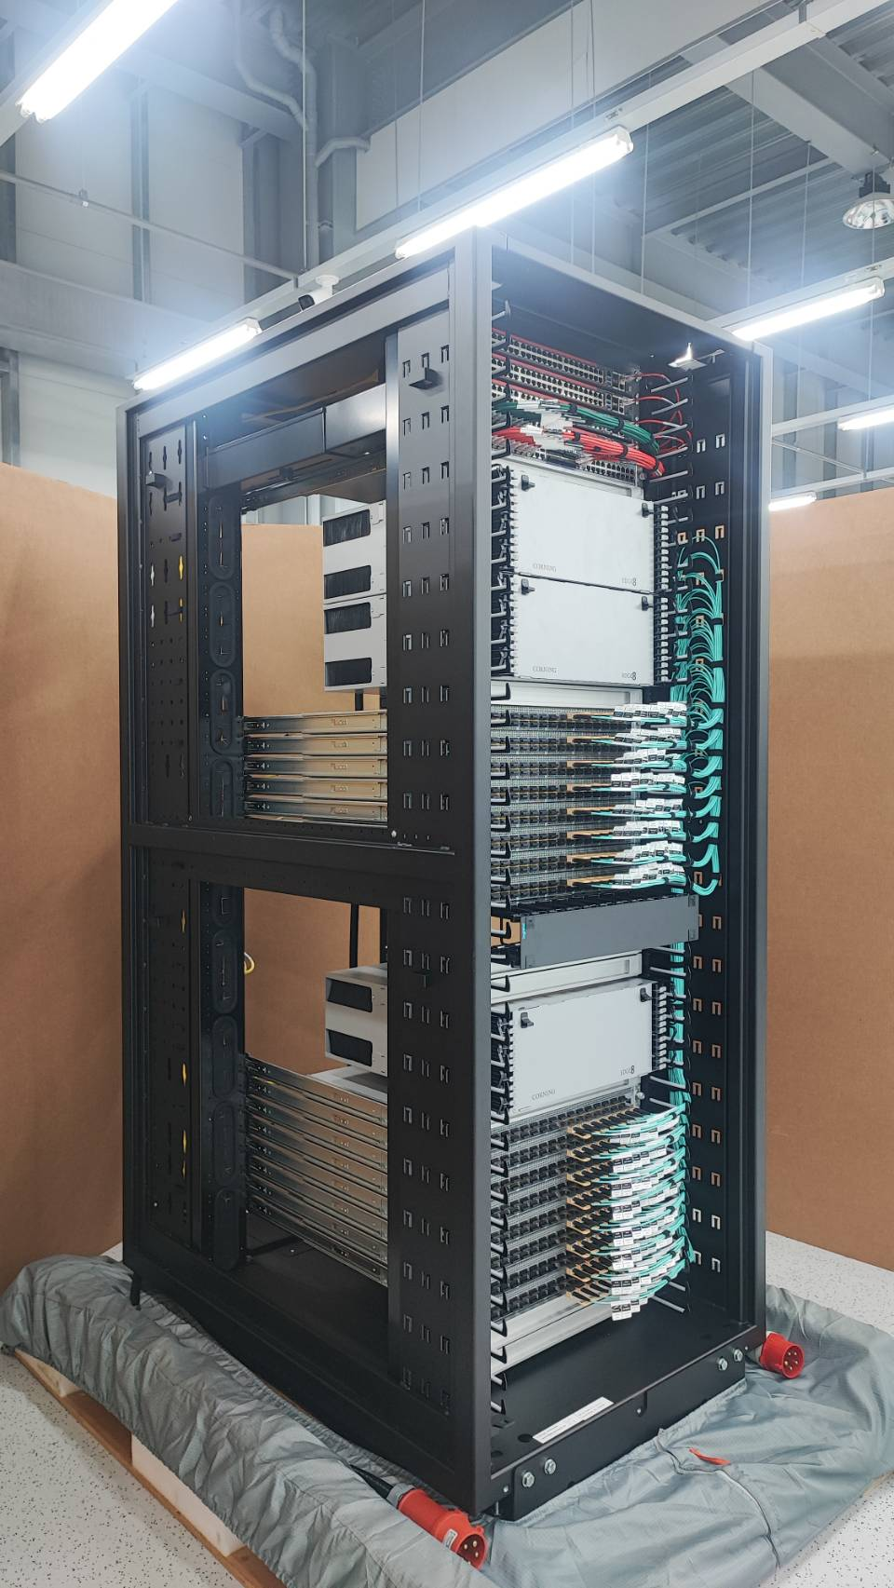
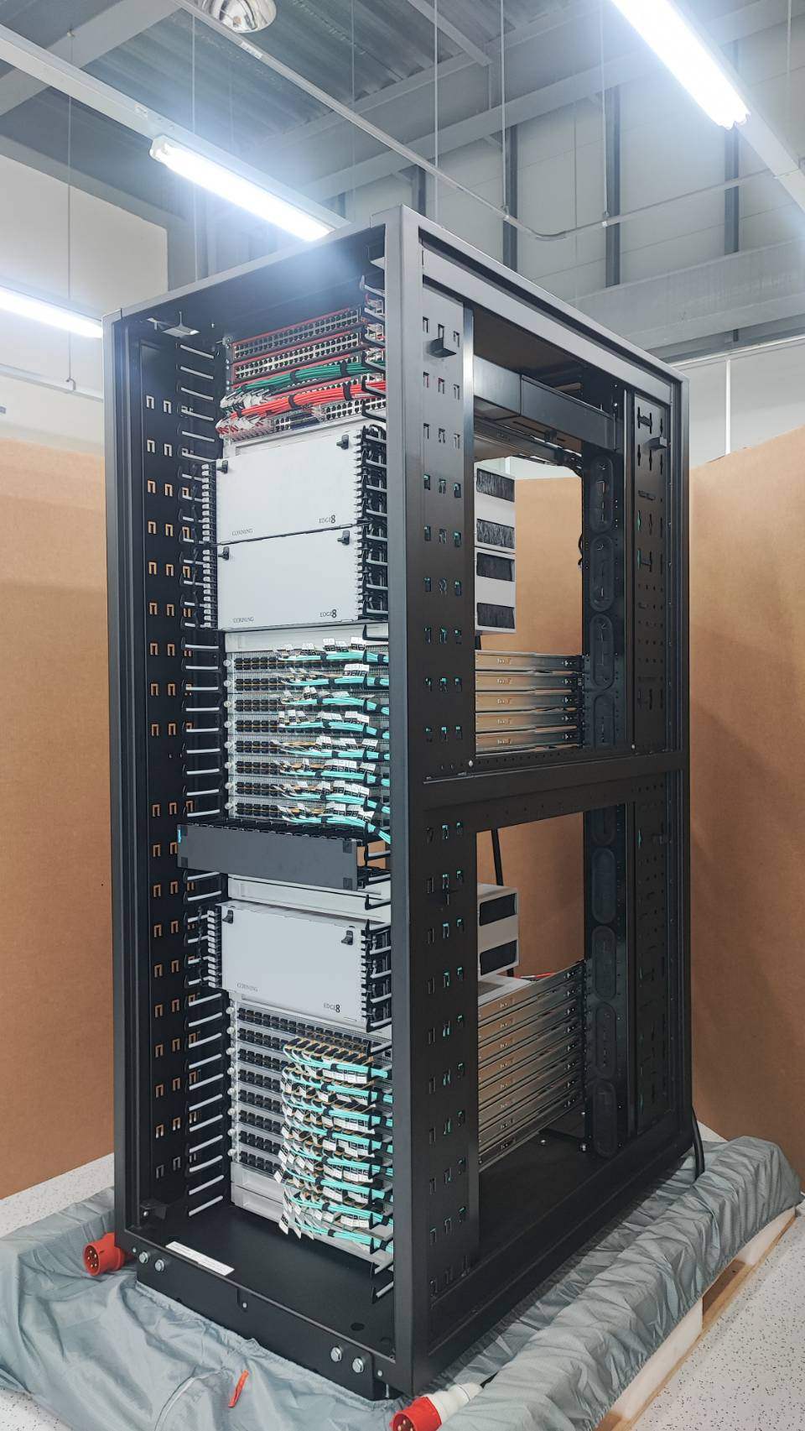

Slide 7
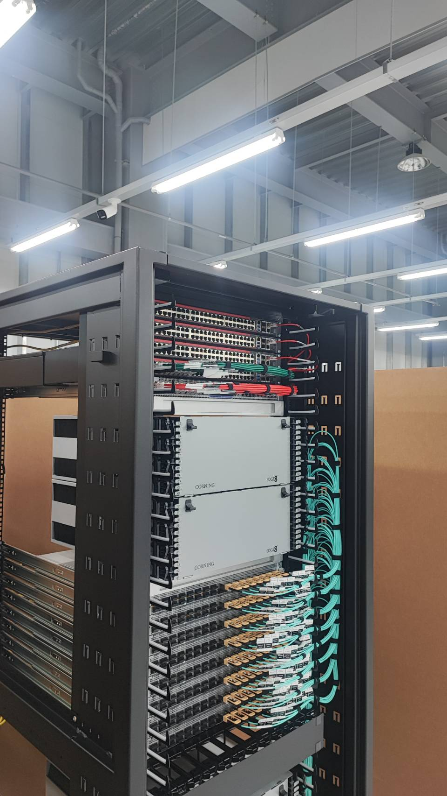
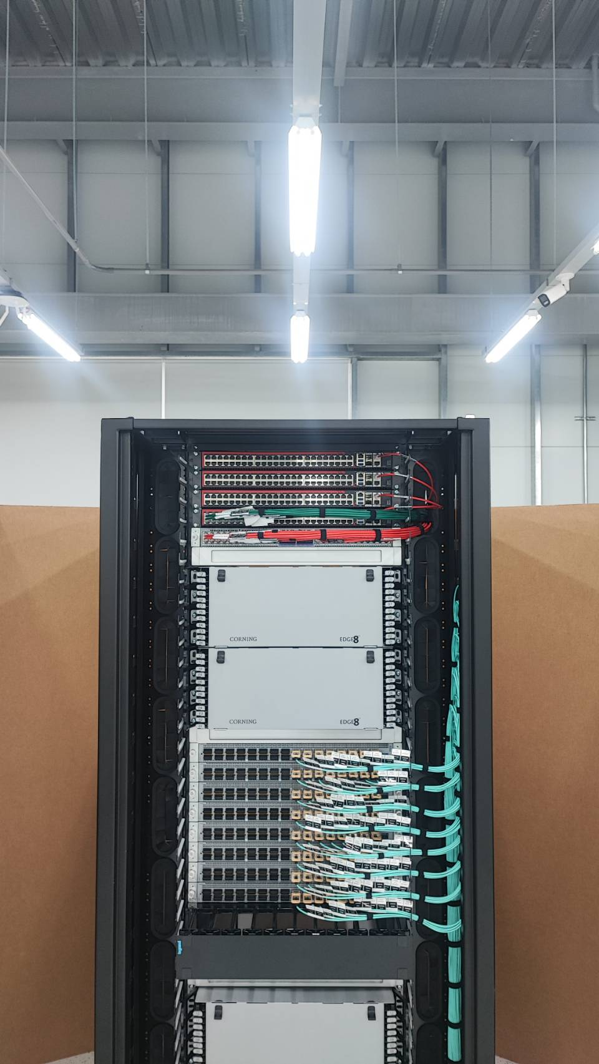
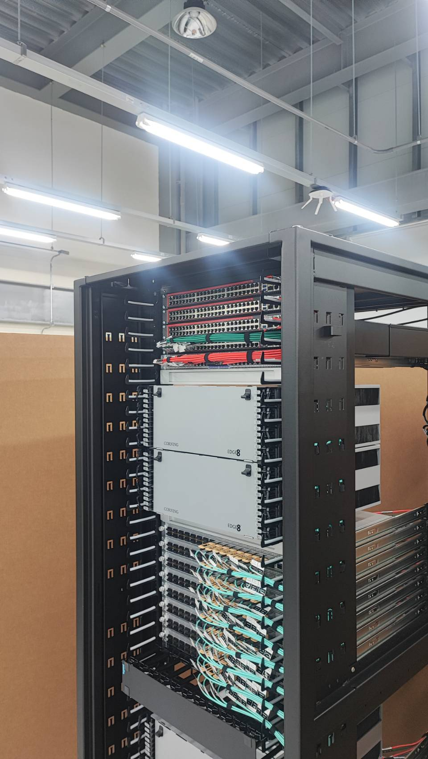

Slide 8
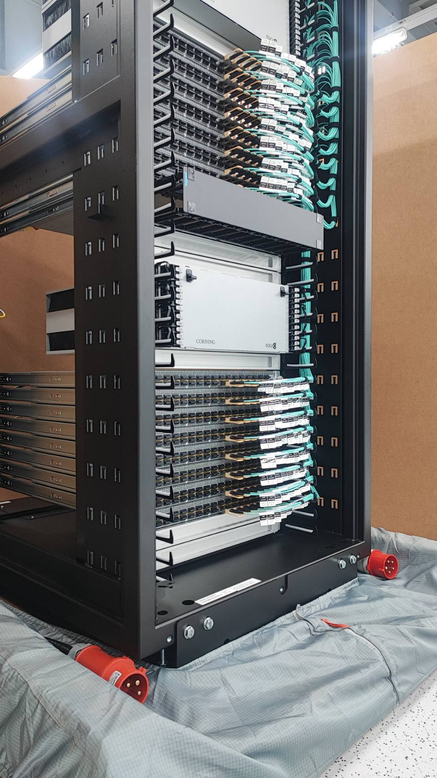
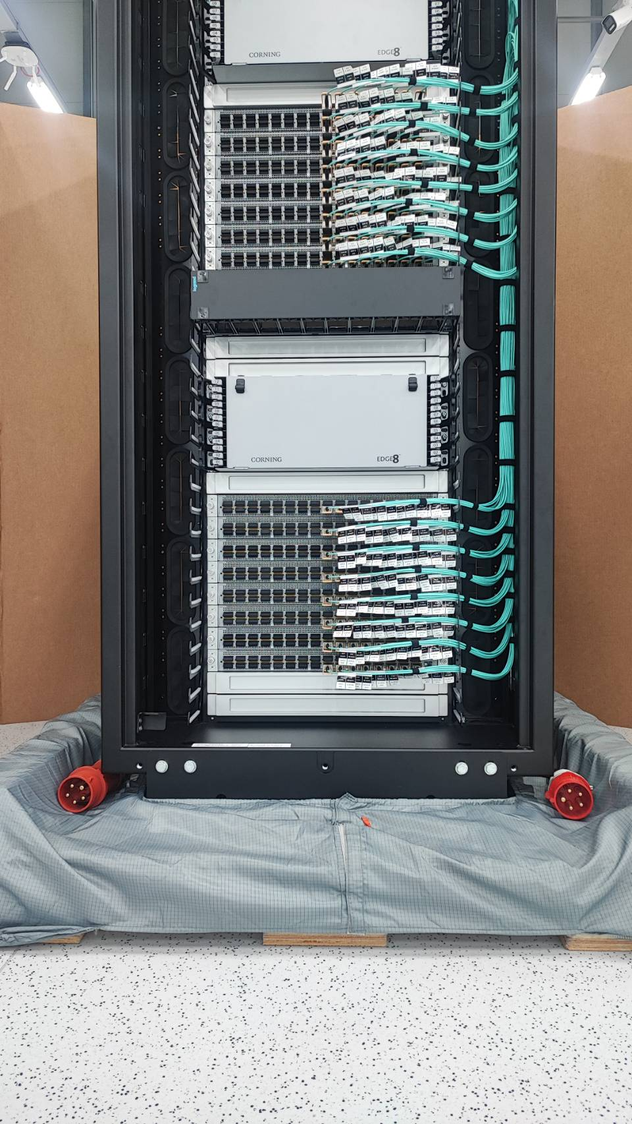
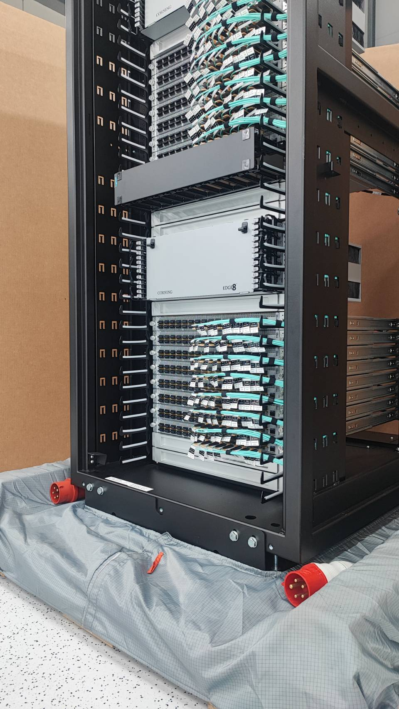

Slide 9
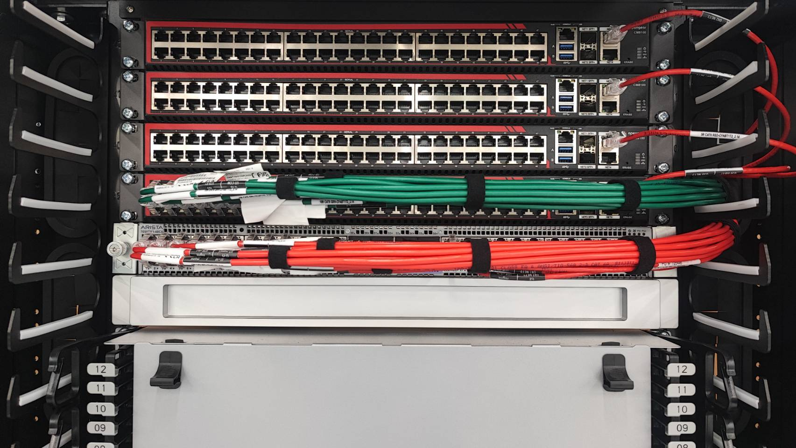
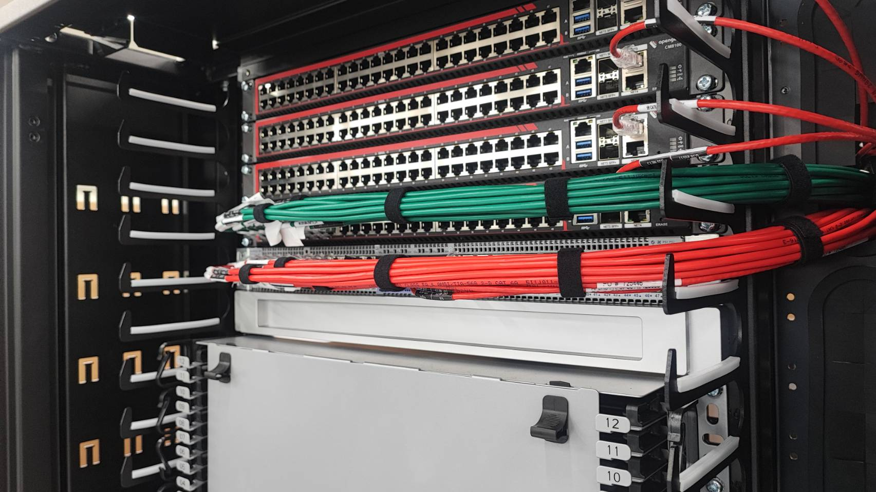
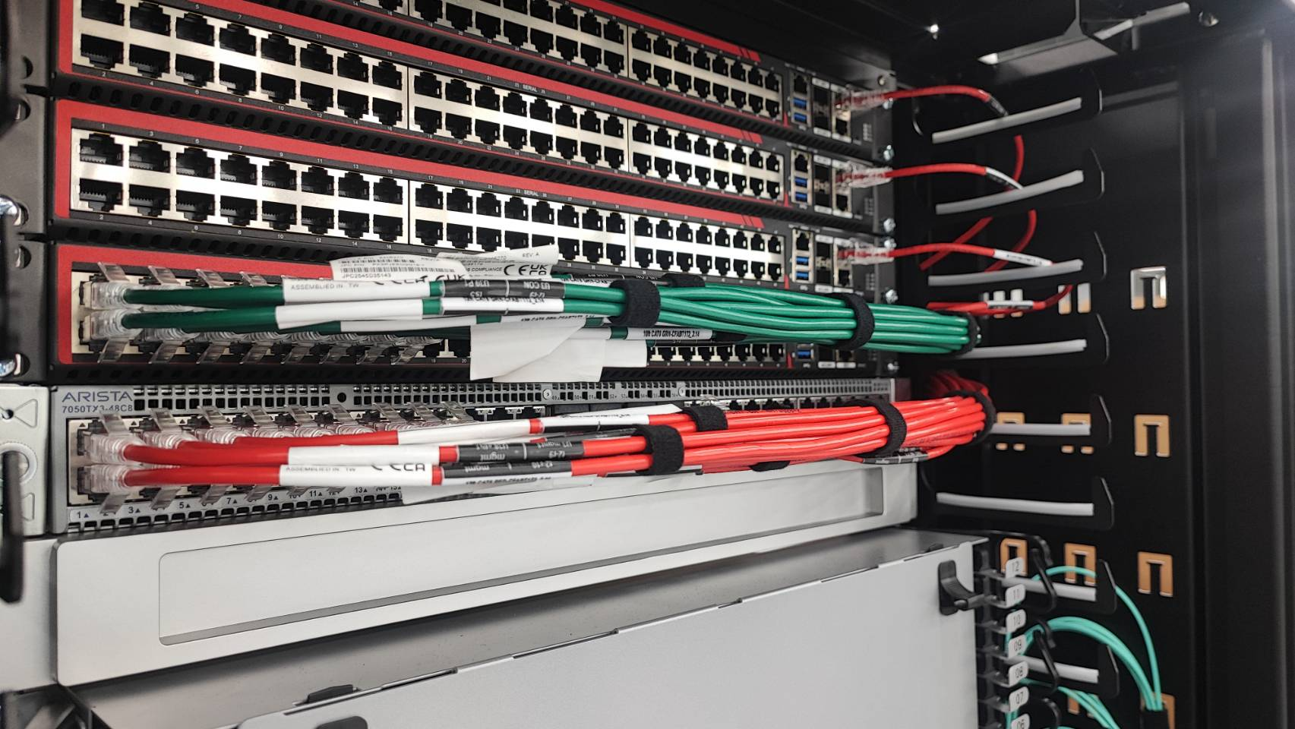
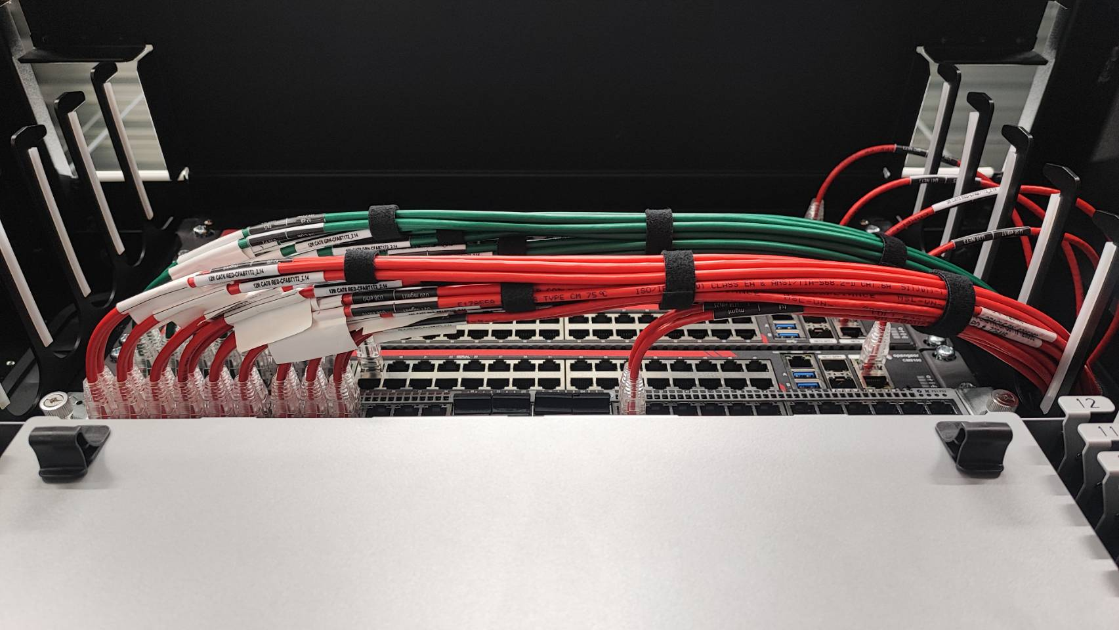

Slide 10
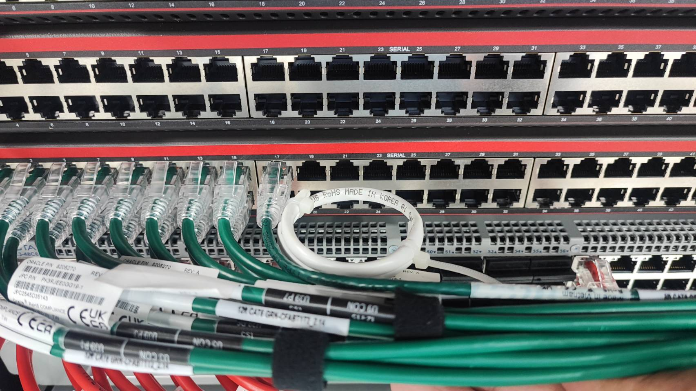
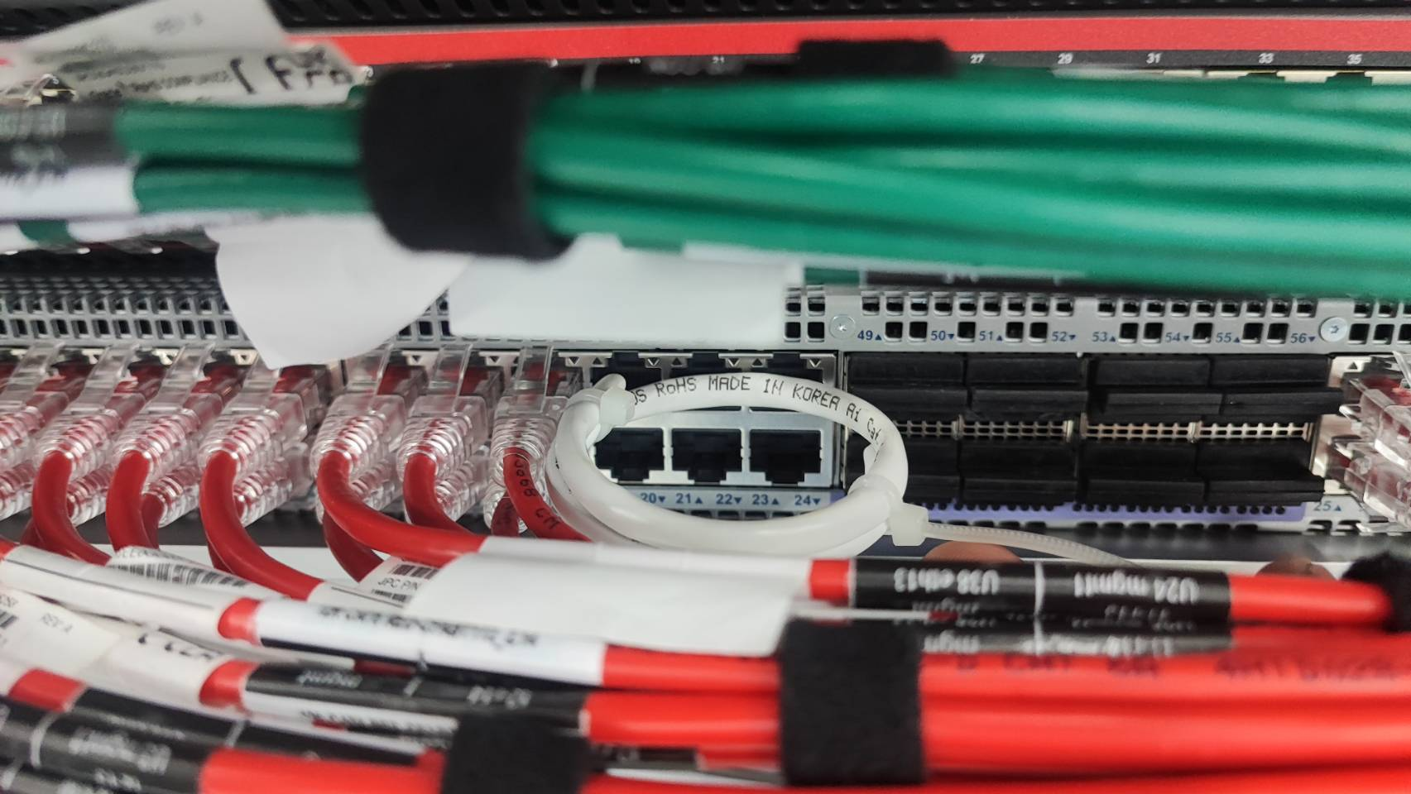
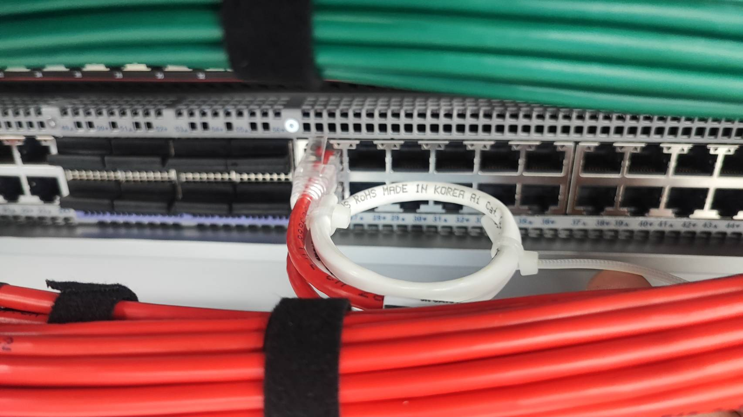

Slide 11
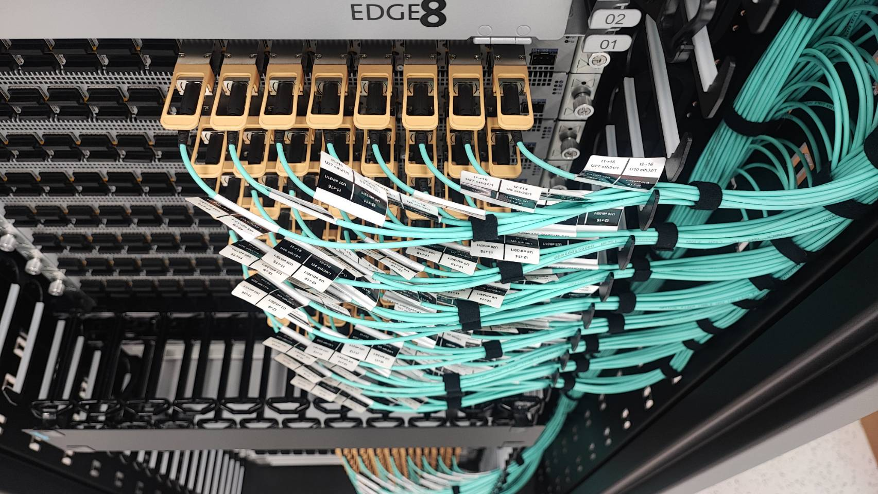
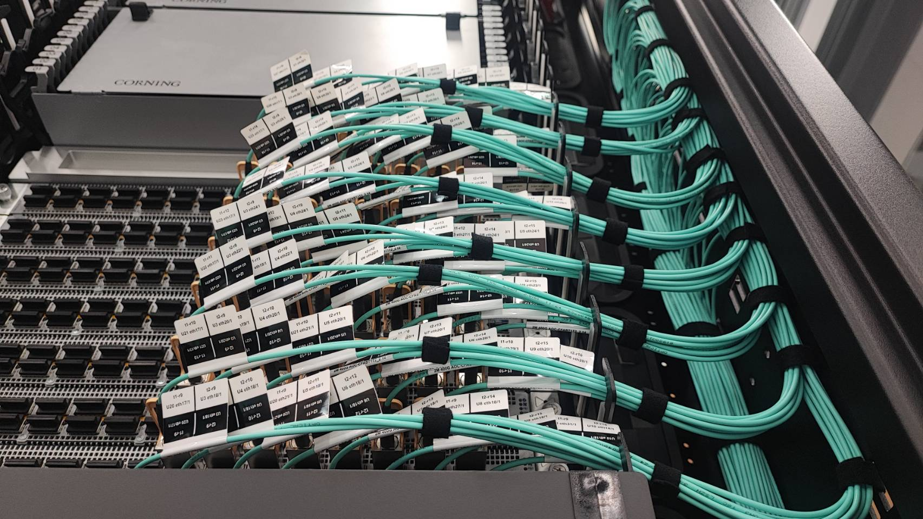
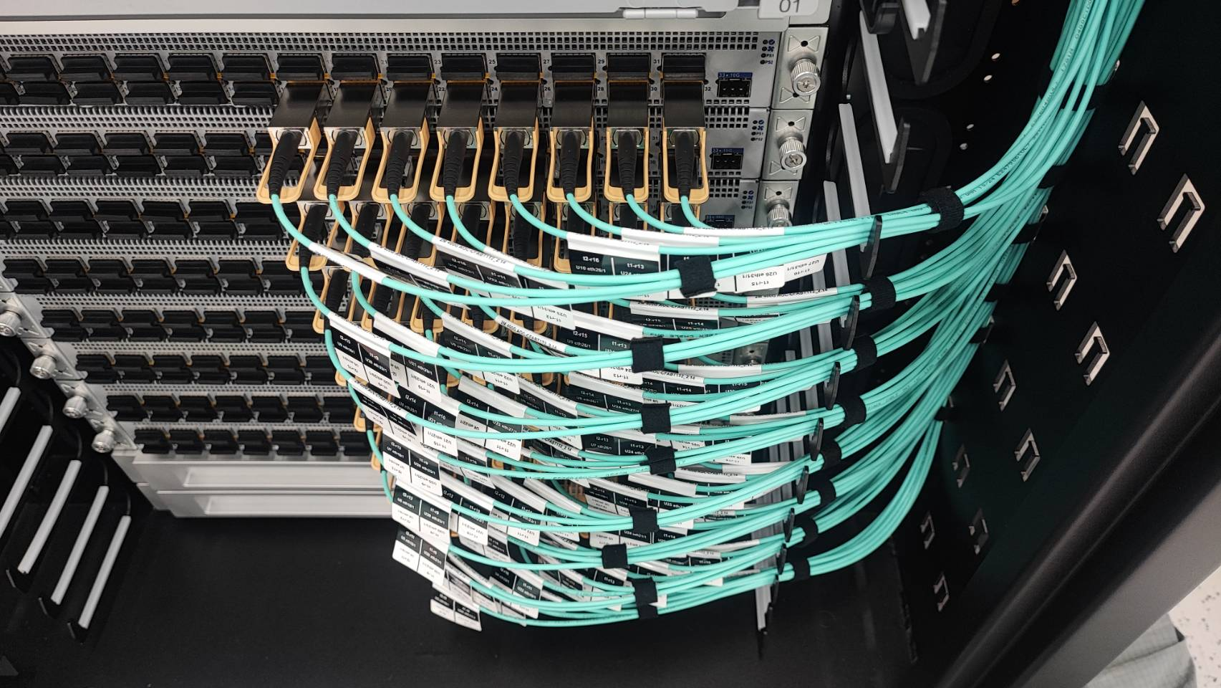
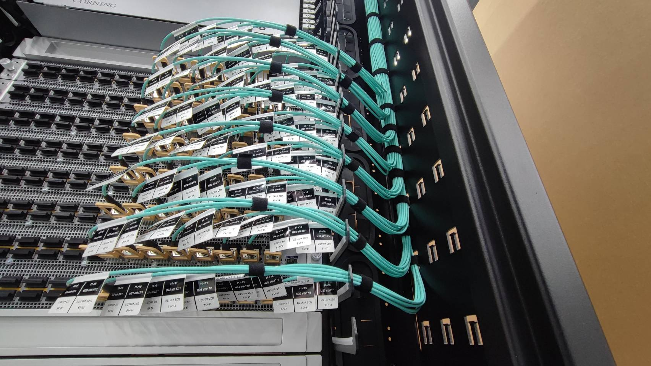

Slide 12
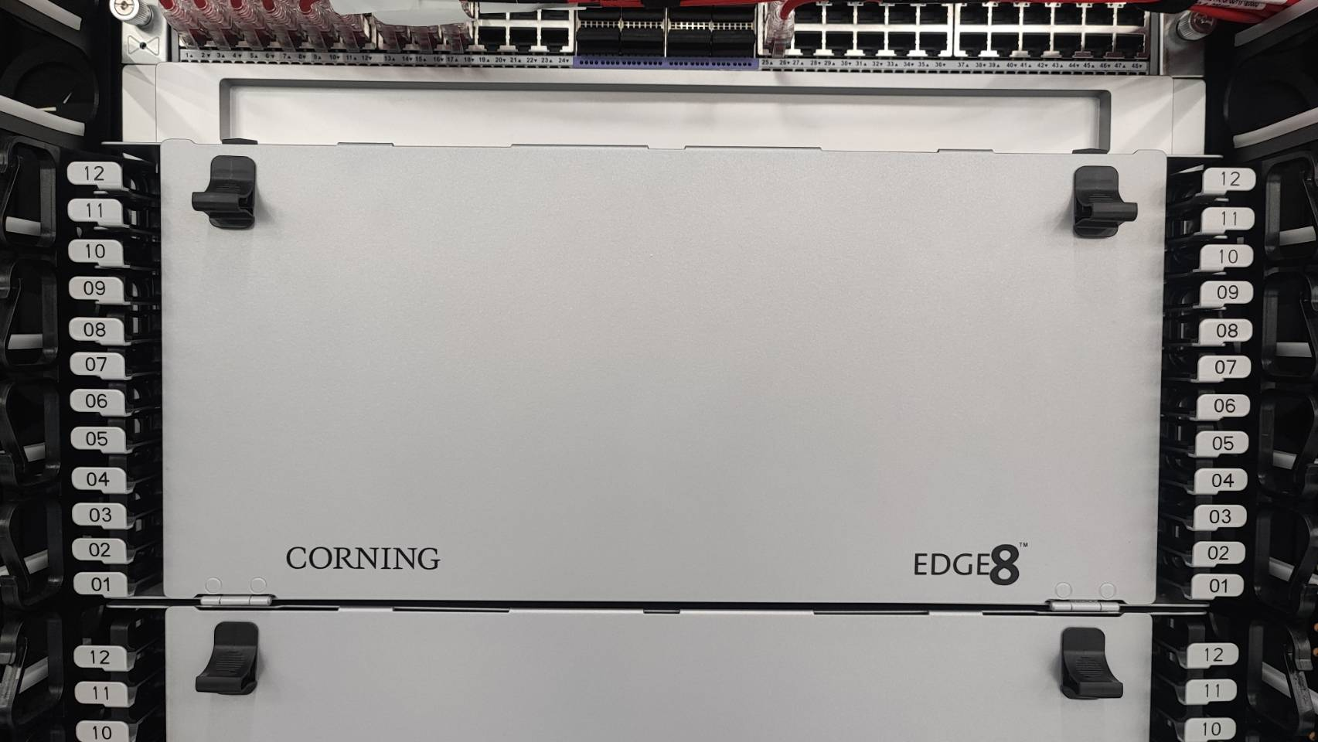
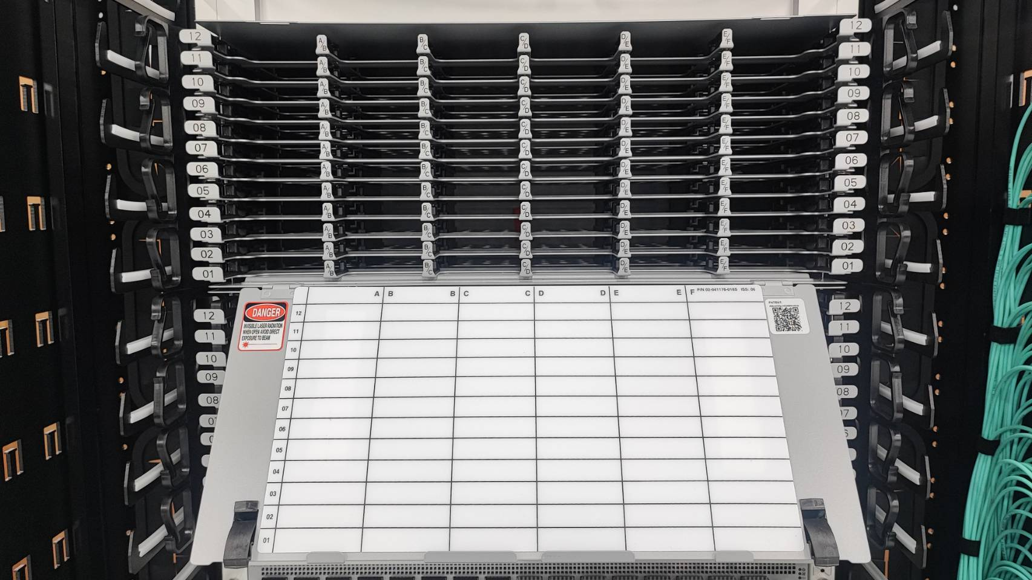
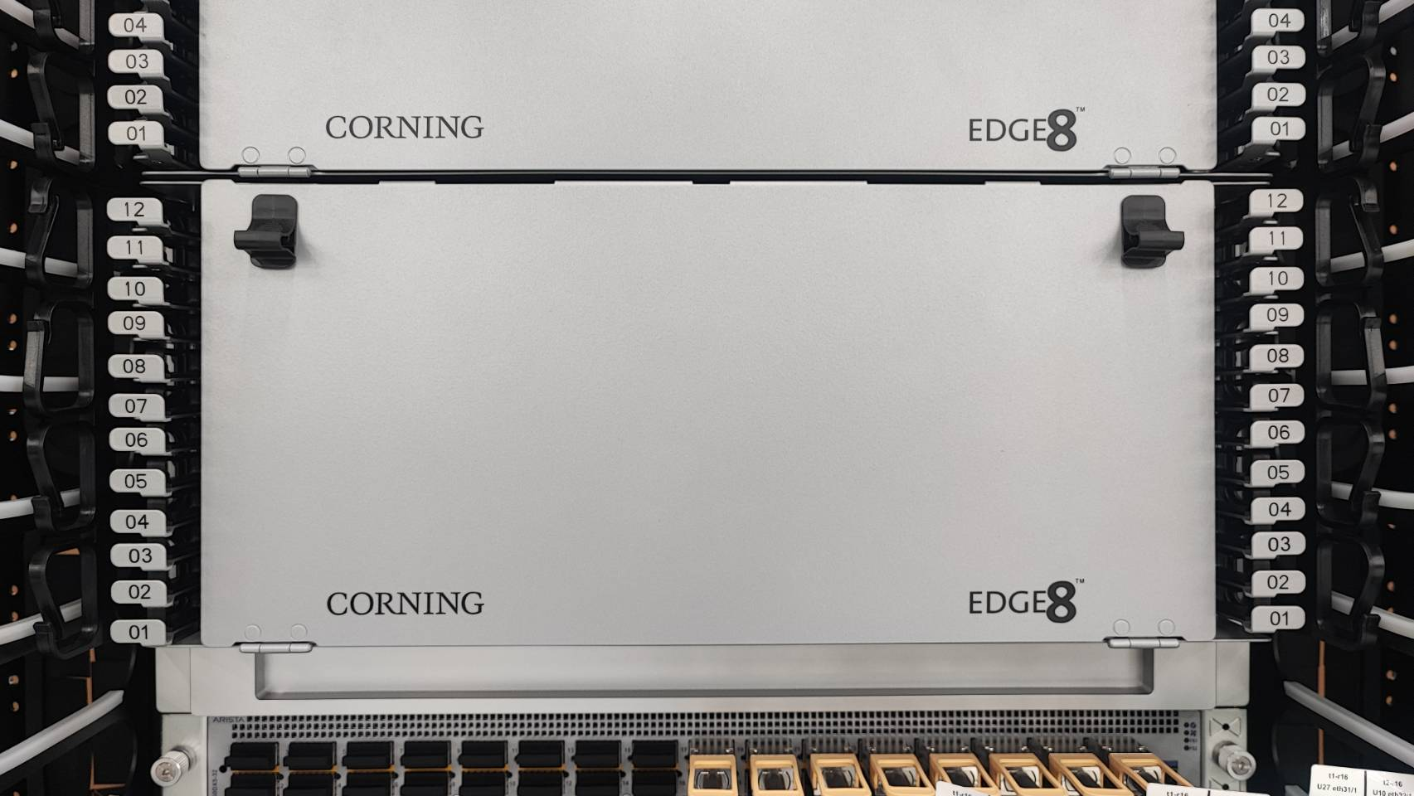
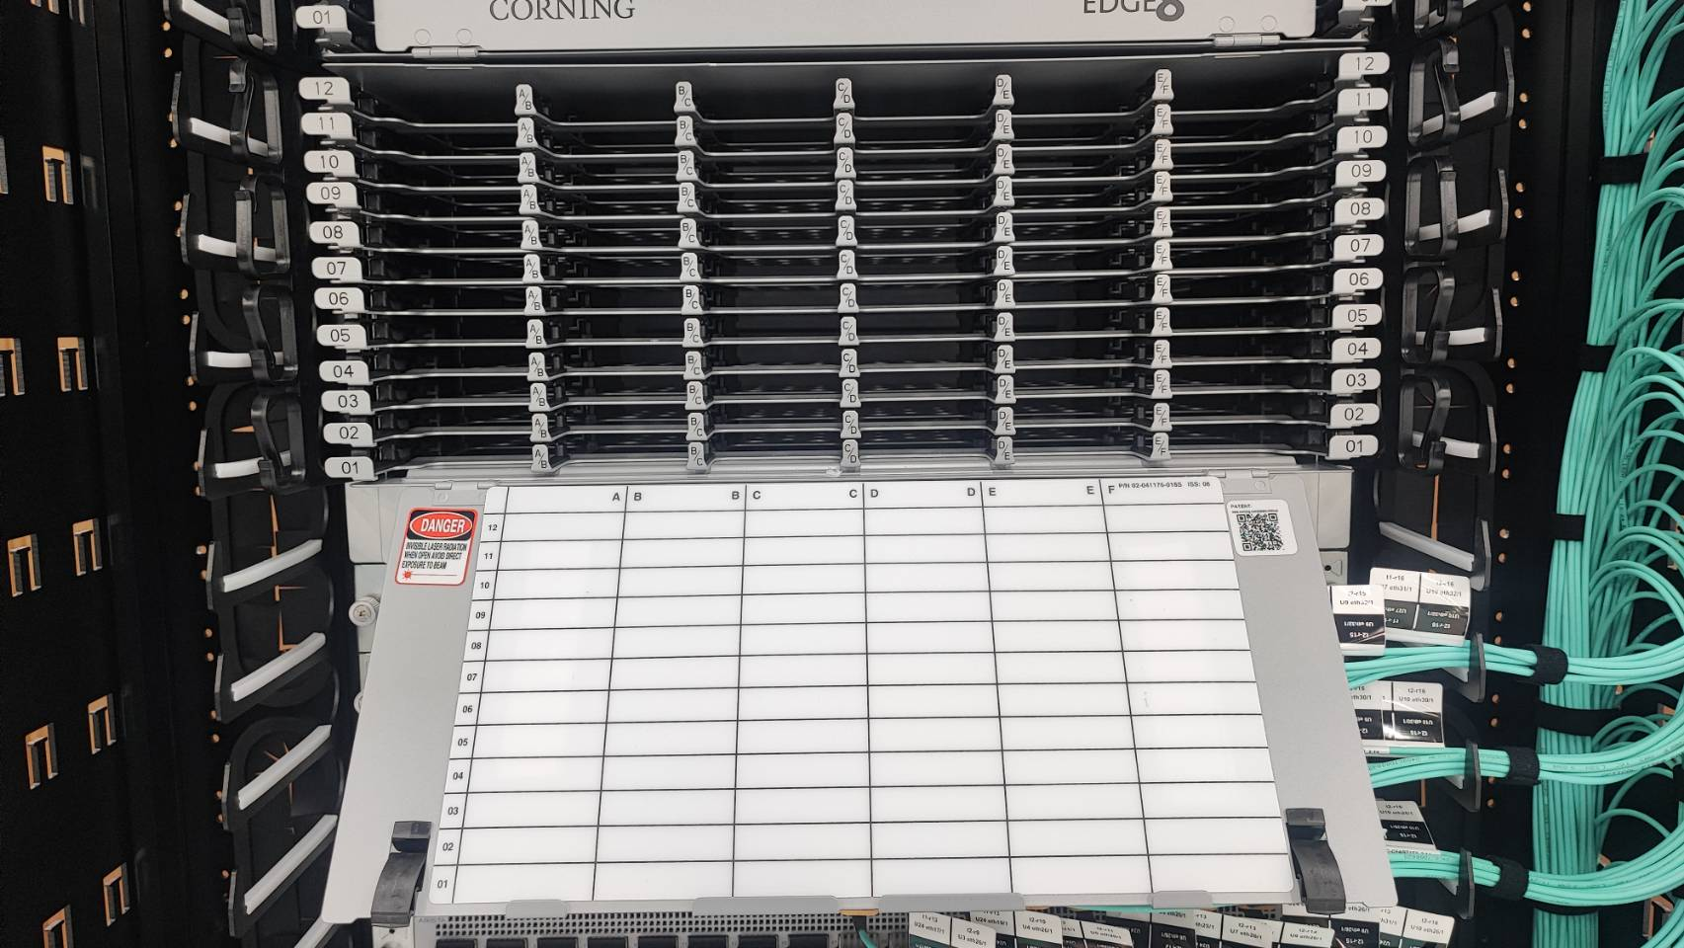

Slide 13
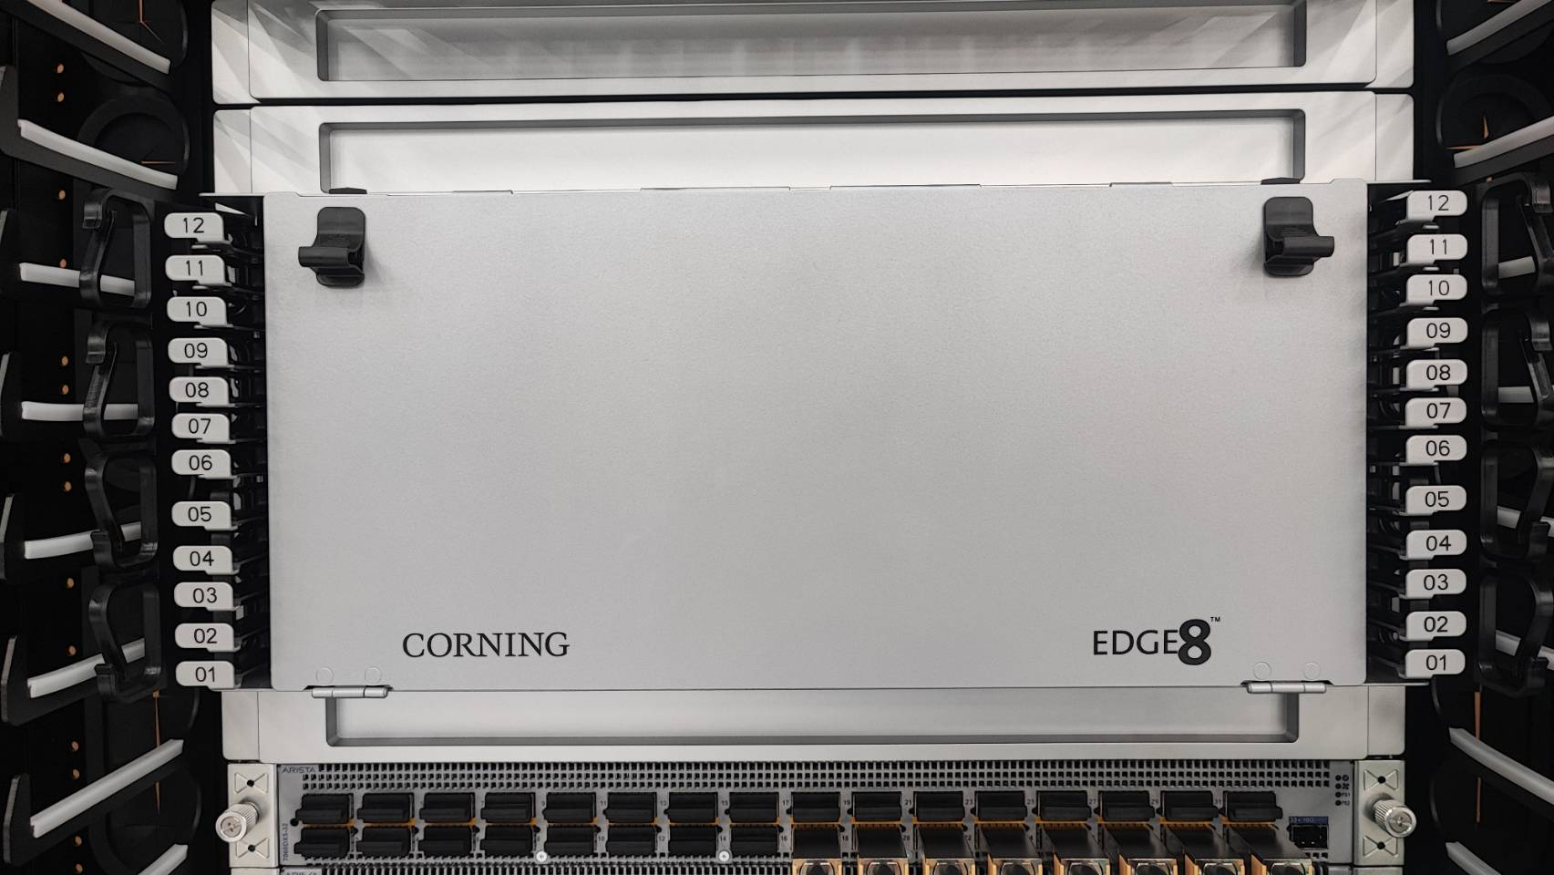
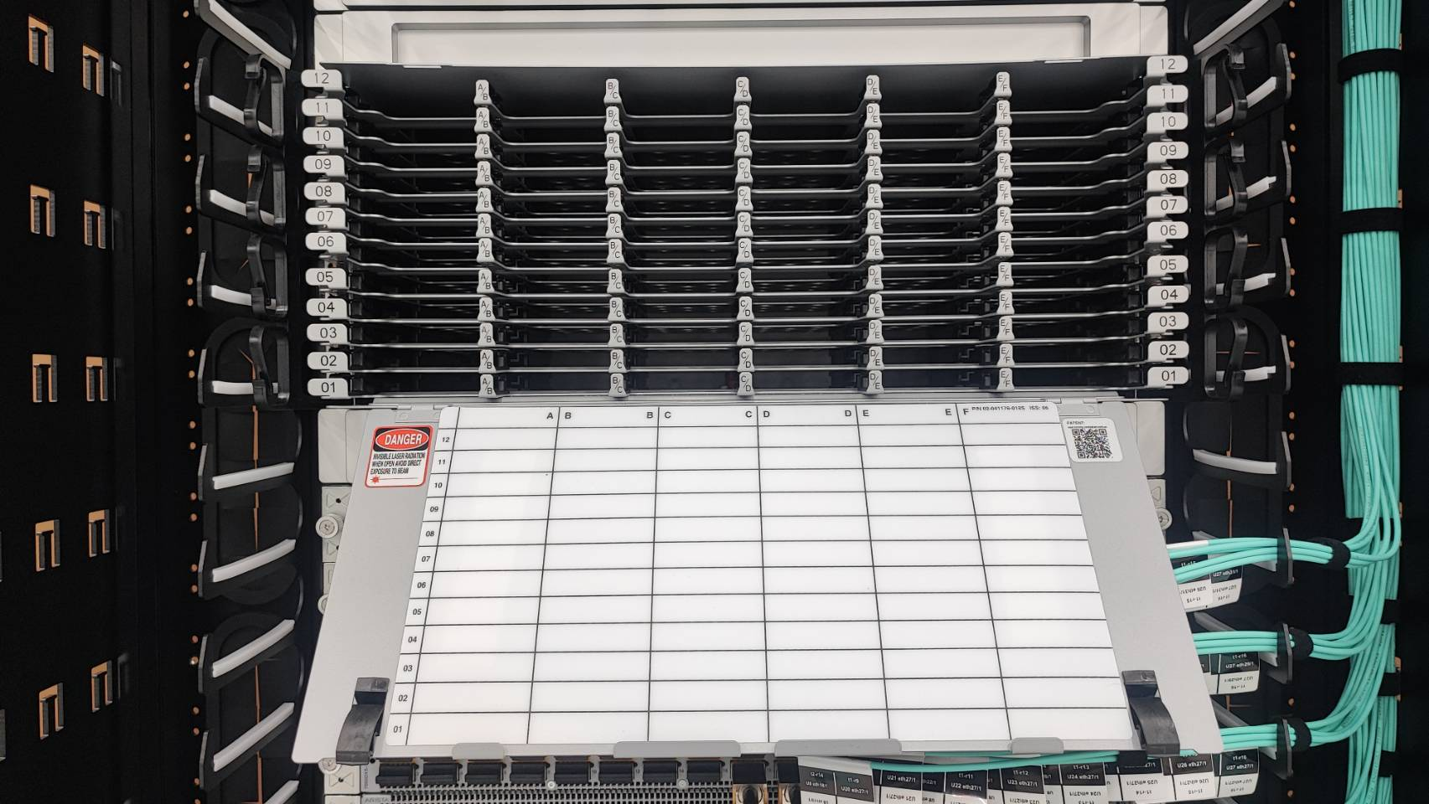

Slide 14
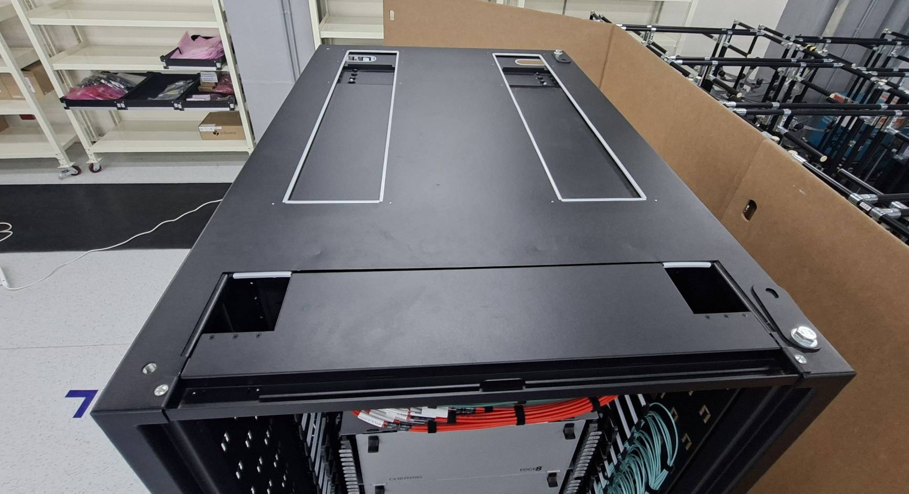
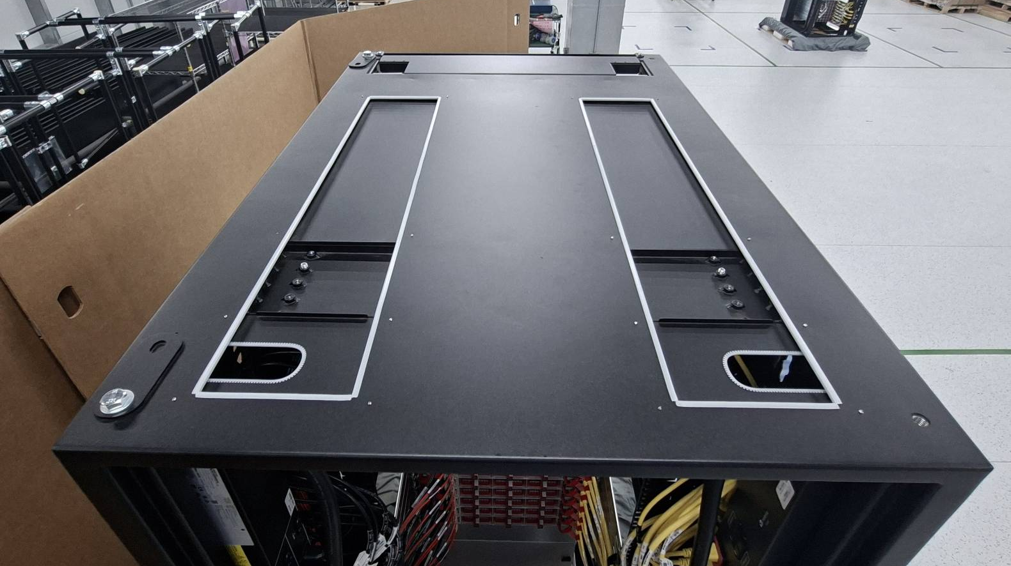

Slide 15
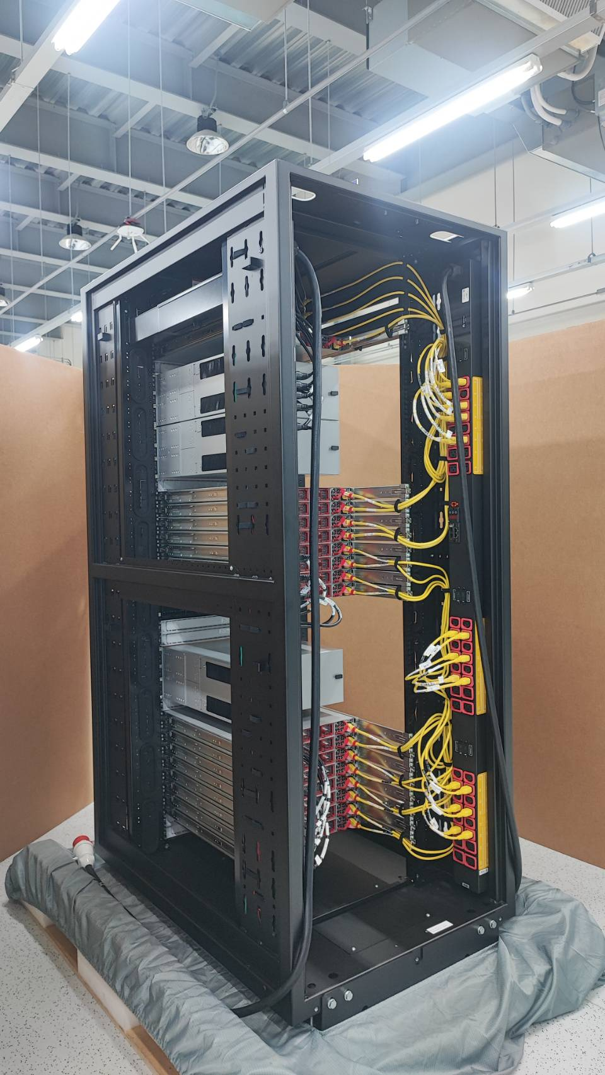
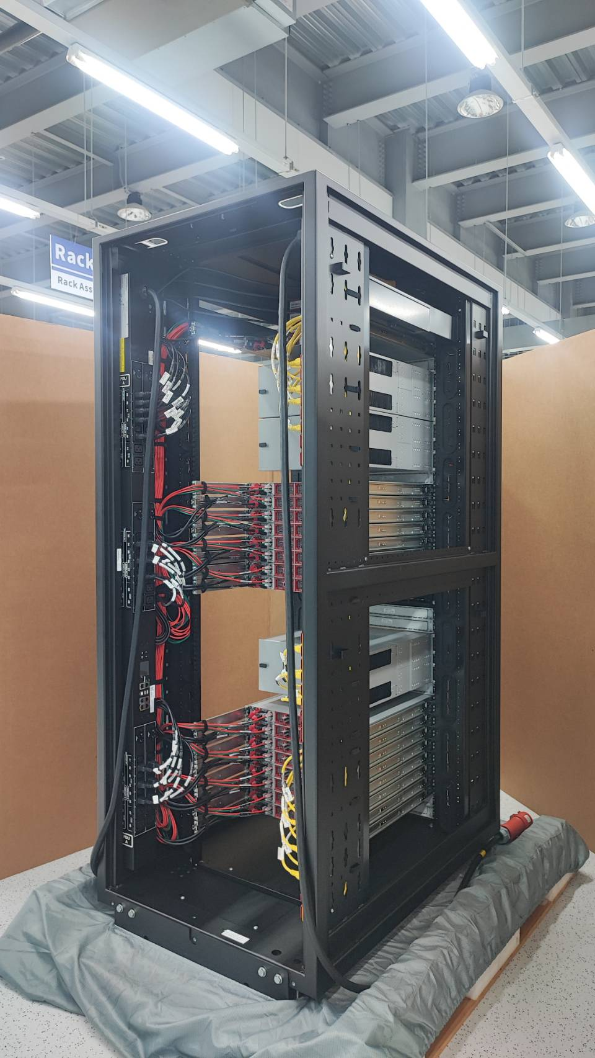

Slide 16
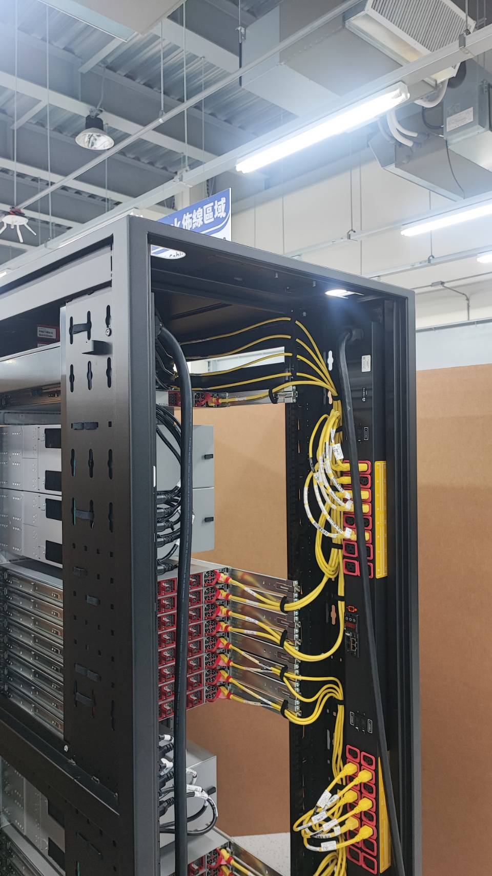
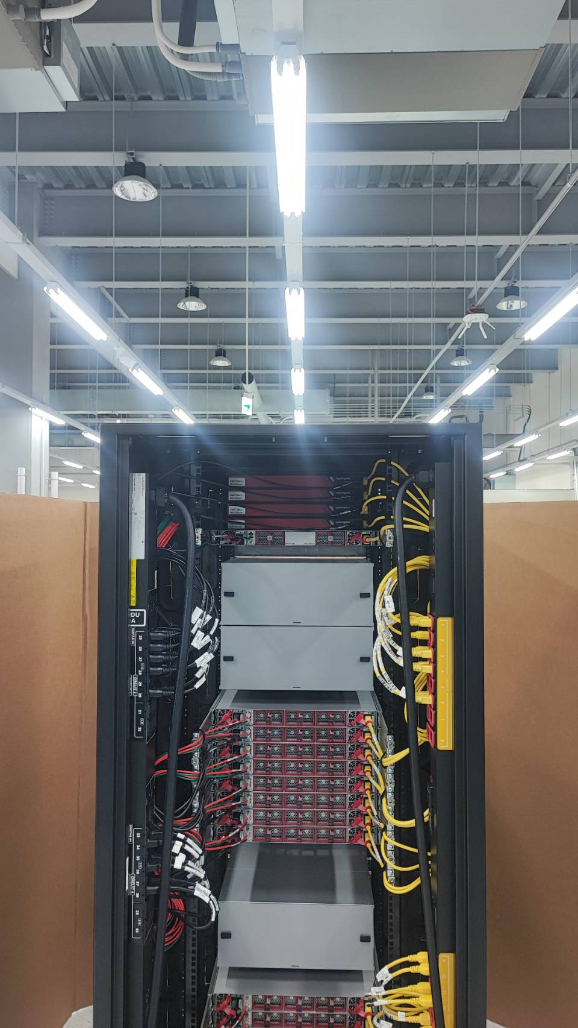
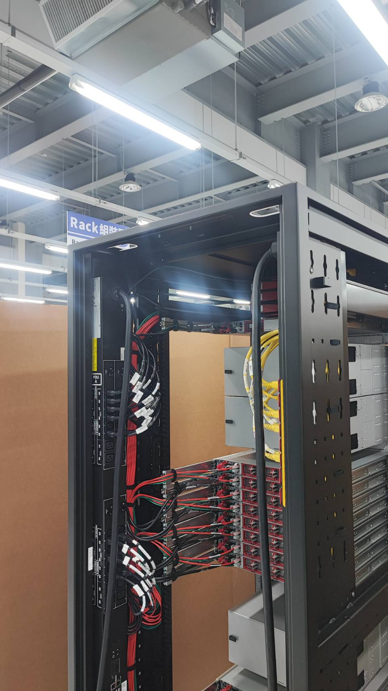

Slide 17
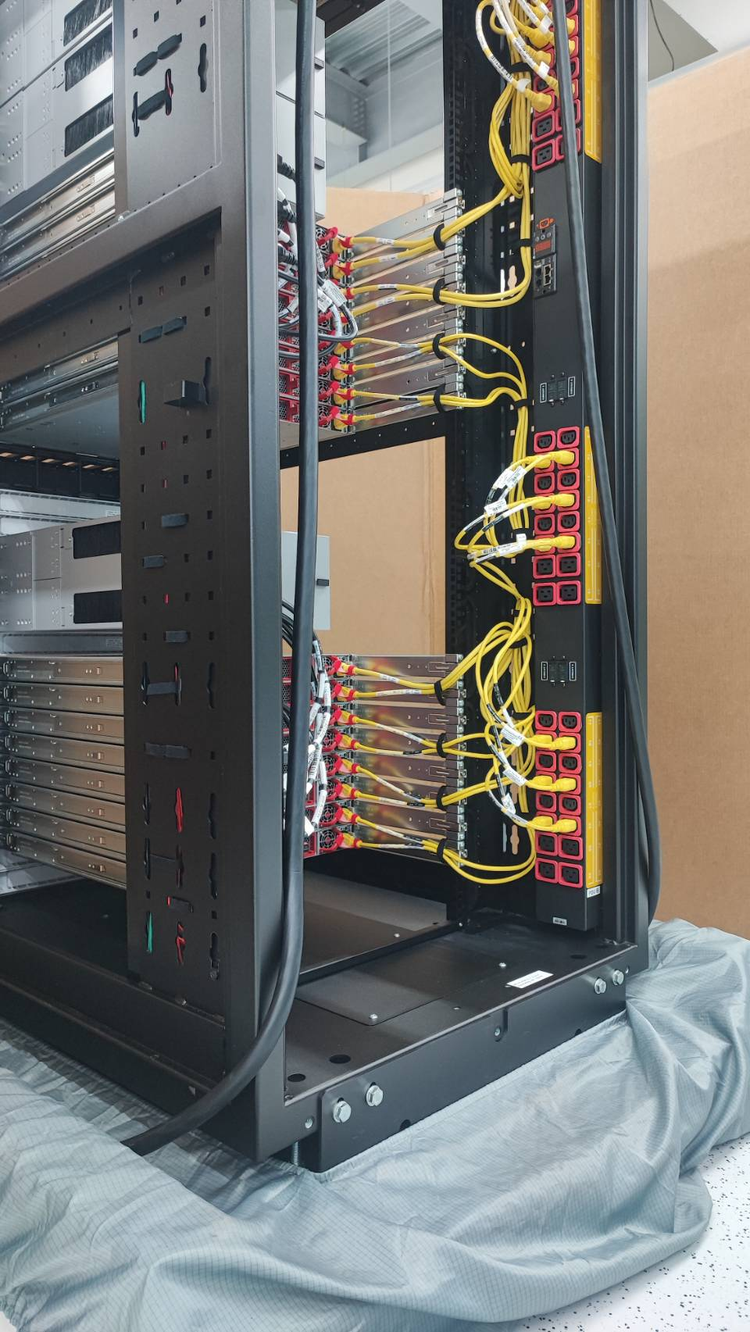
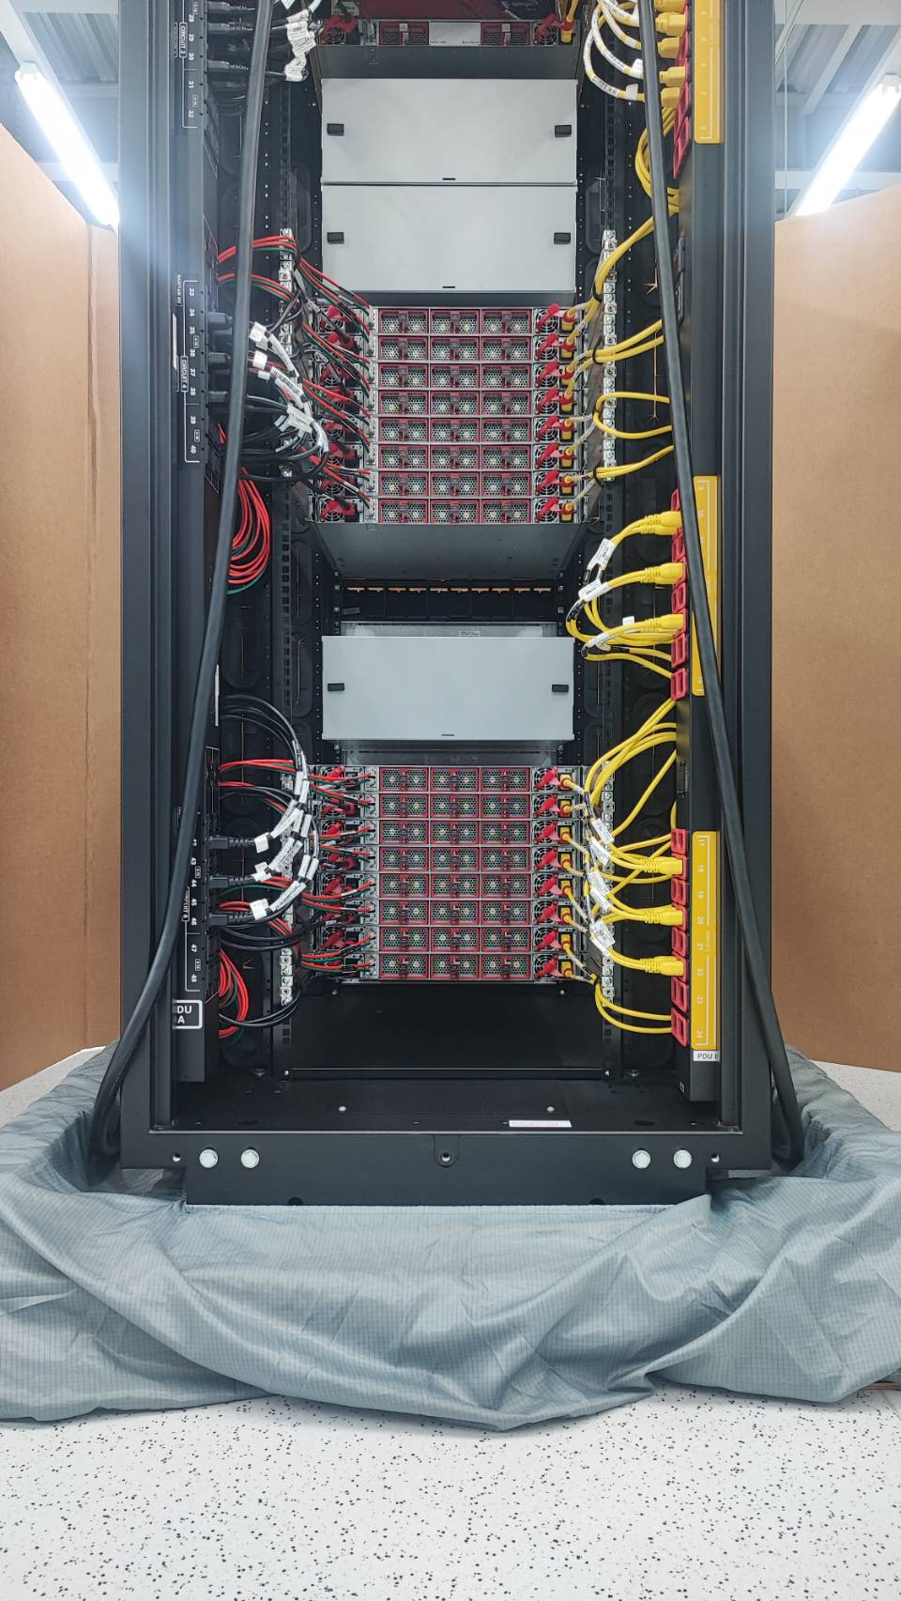
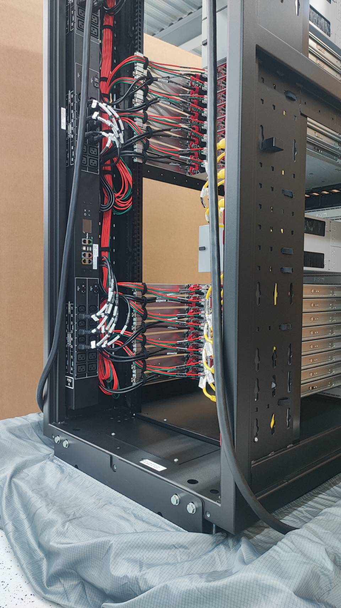

Slide 18
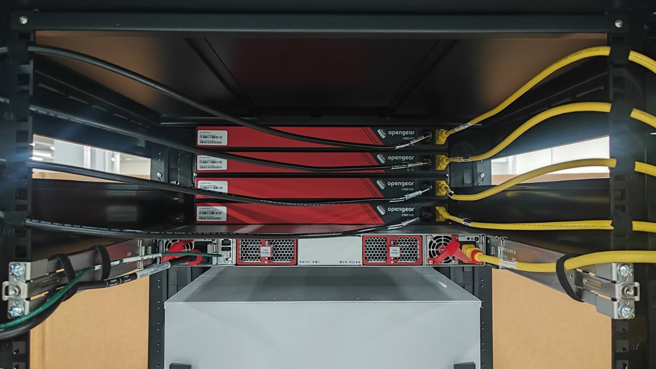
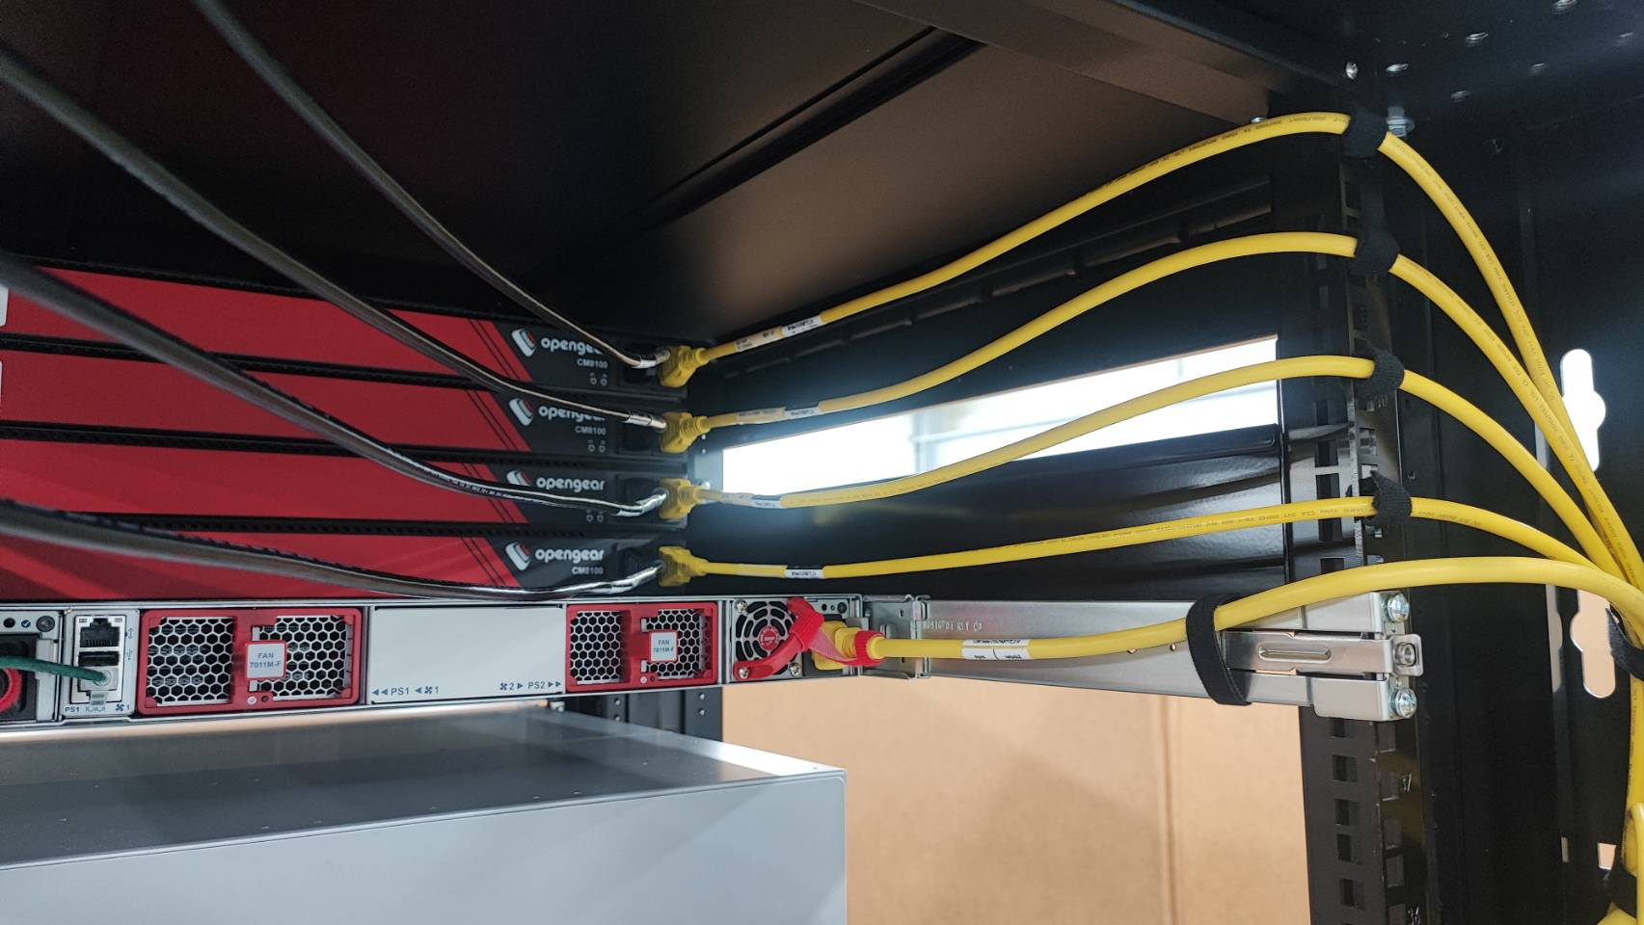
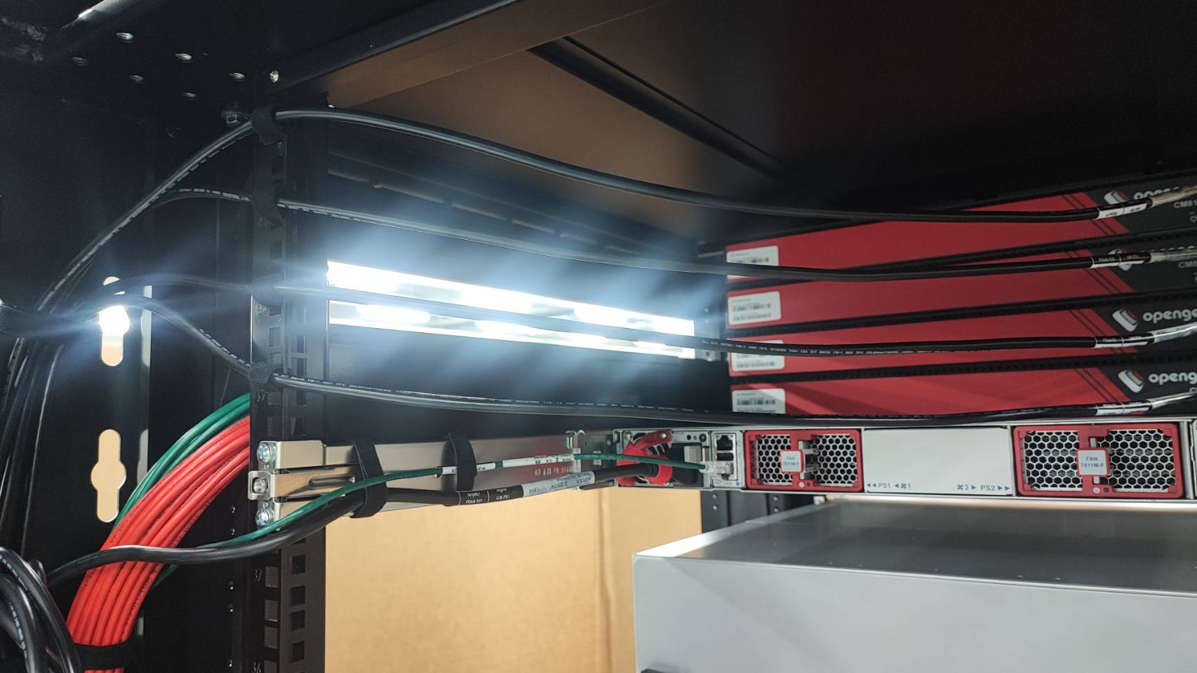

Slide 19
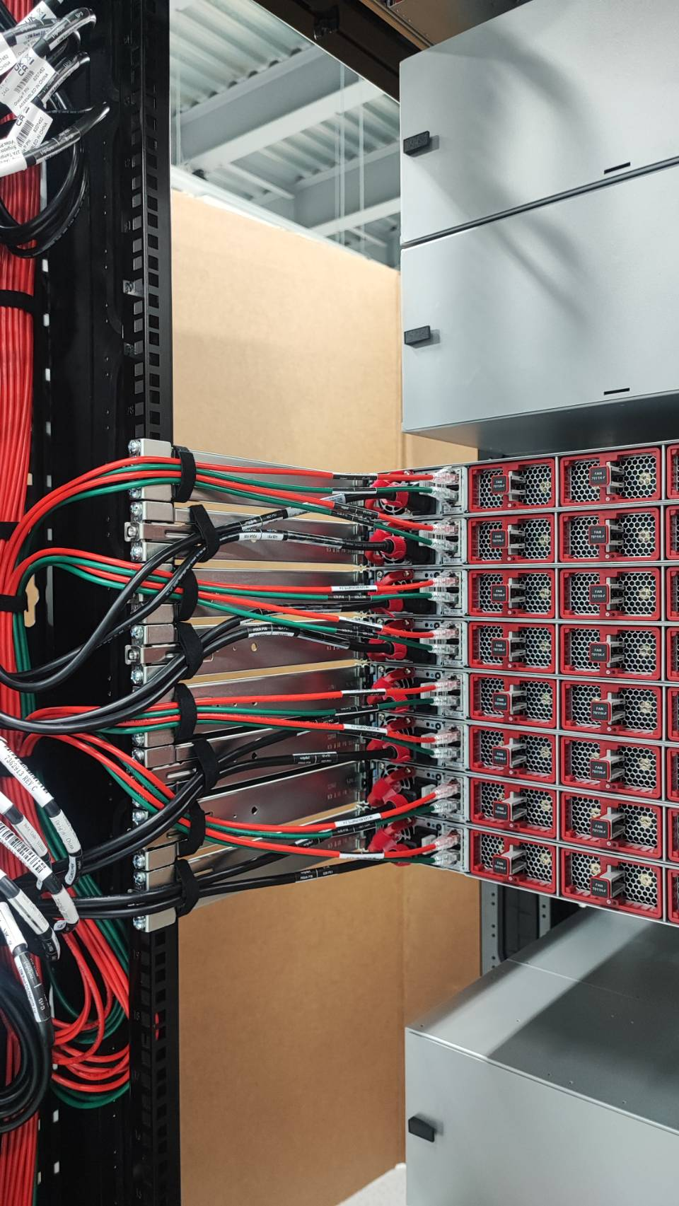
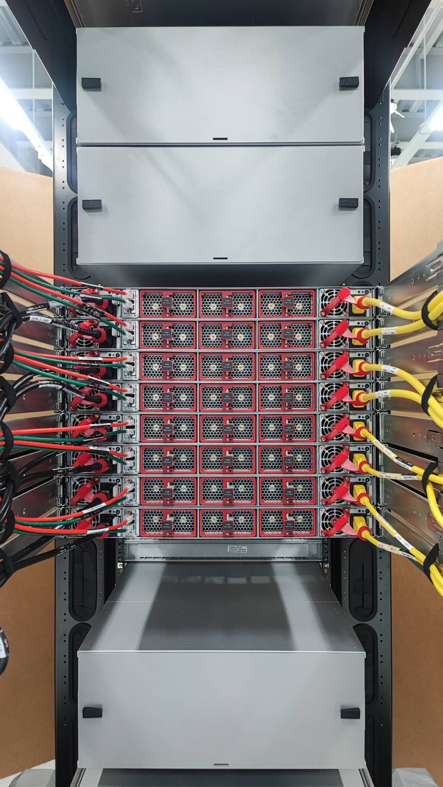
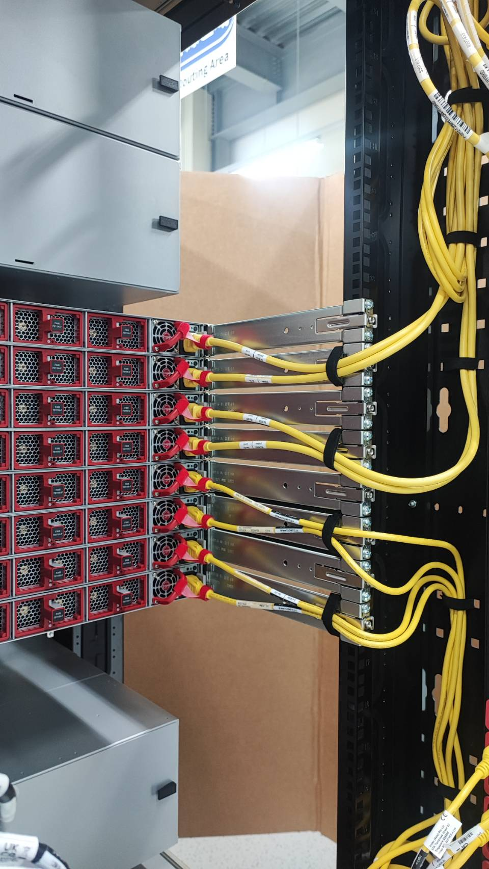

Slide 20
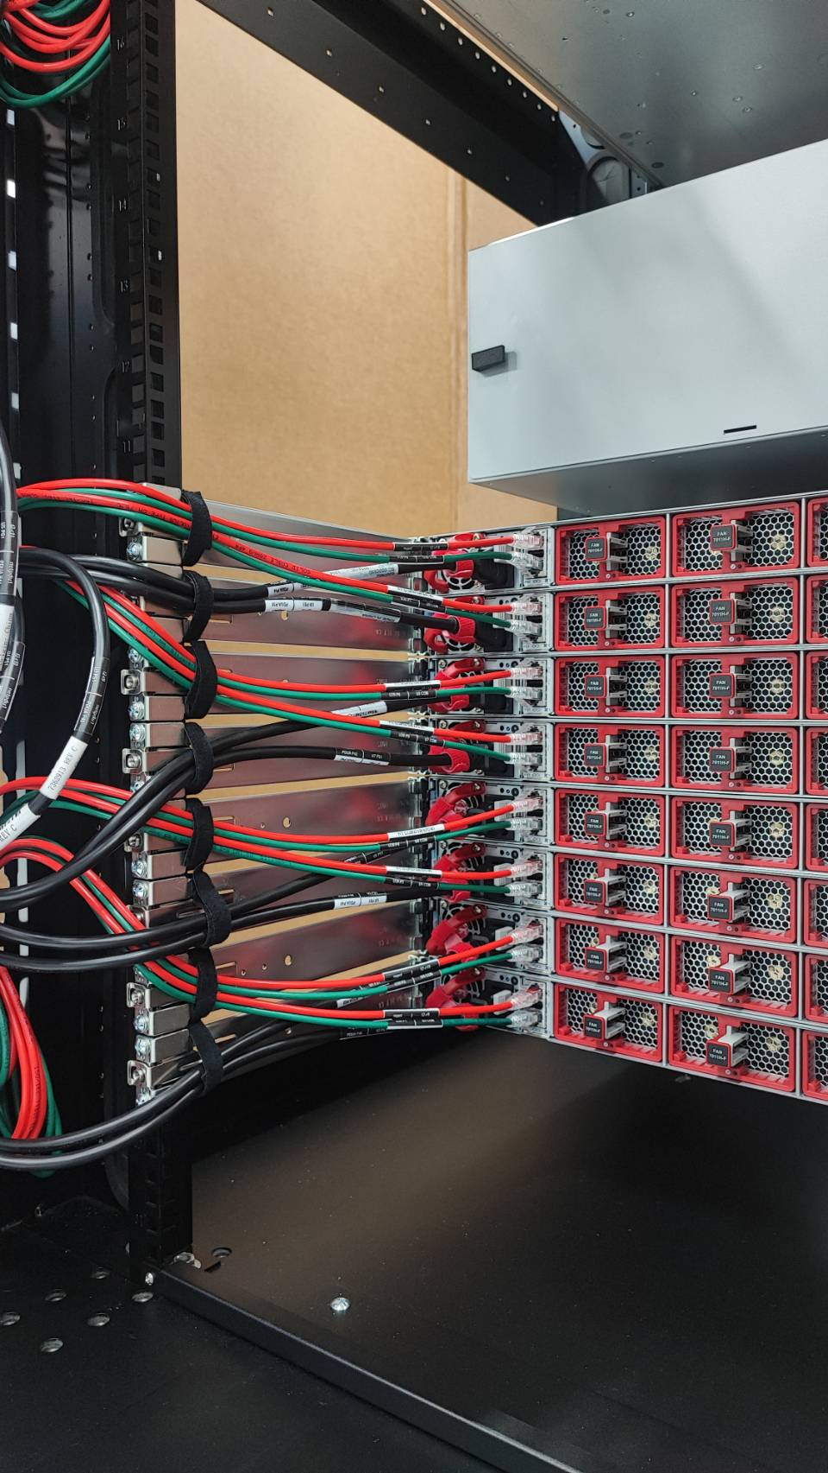
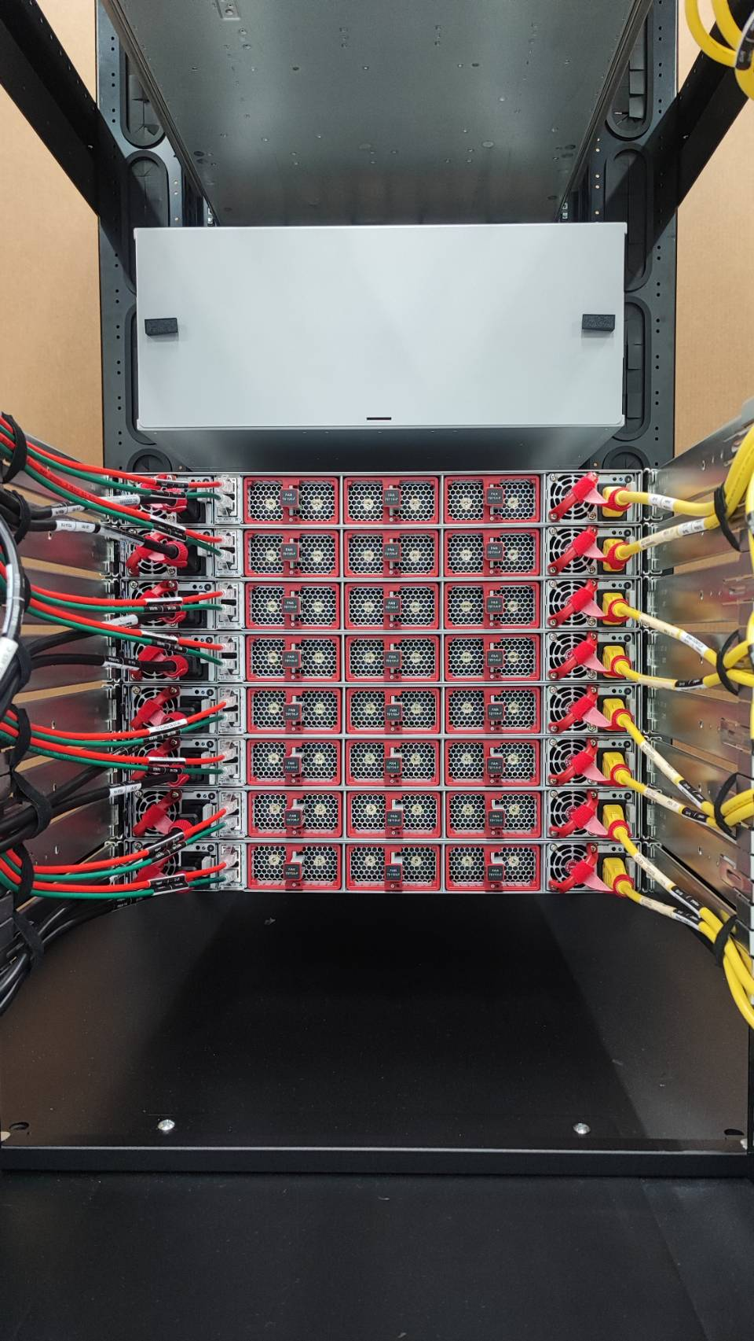
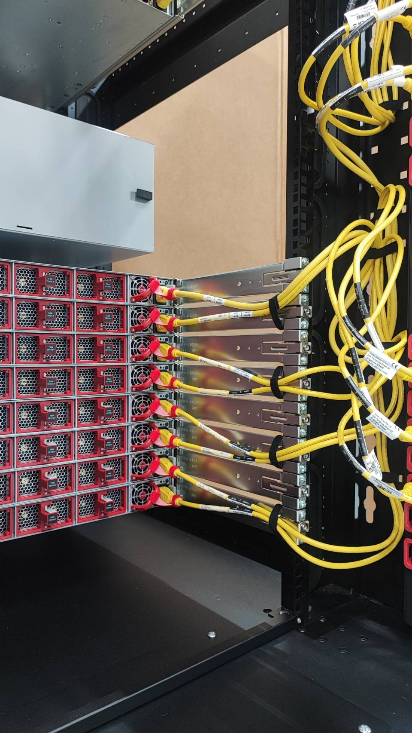

Slide 21
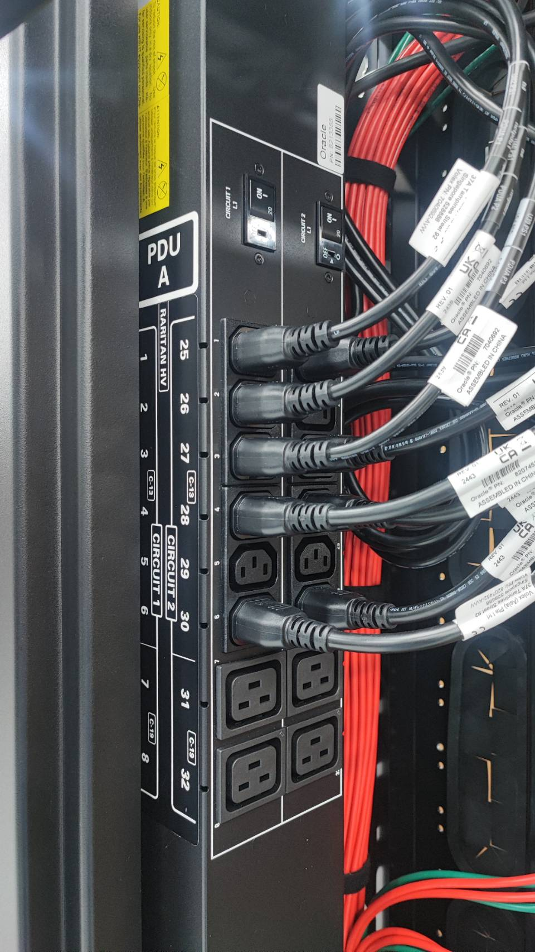
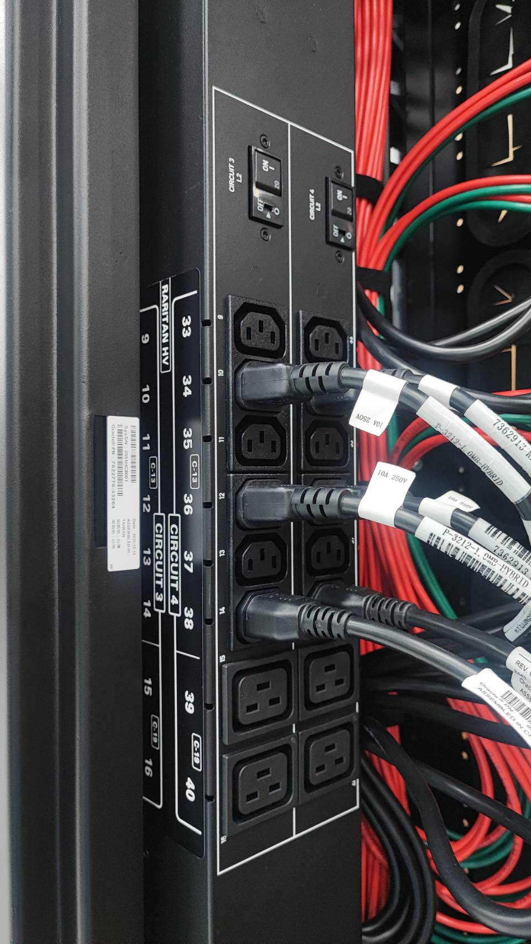


Slide 22




Slide 23



Slide 24



Slide 25


Slide 26



Slide 27





Slide 28





Slide 29



